Slide 1
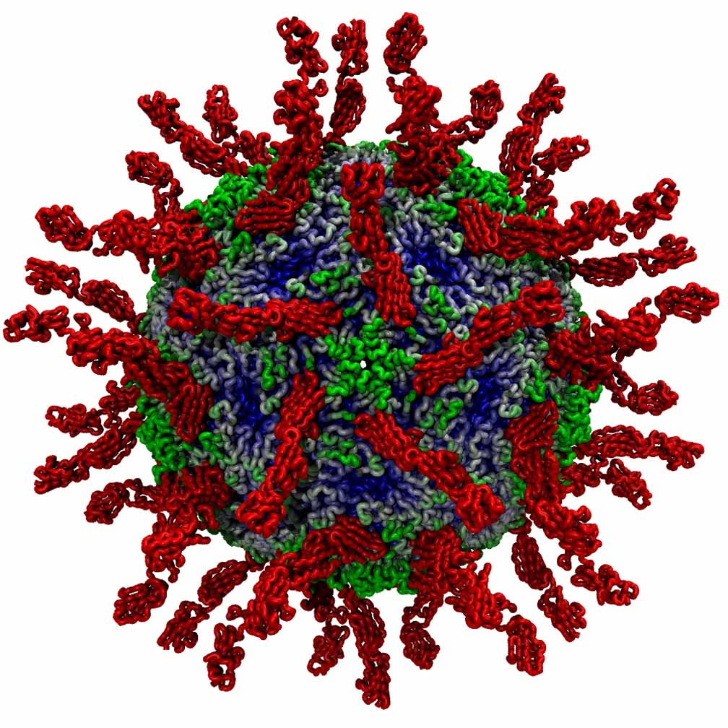
The Dataset Virus: The Infection of Ideas Through Data
Larry Zitnick
Microsoft

Slide 2
Let’s look back…

Slide 3
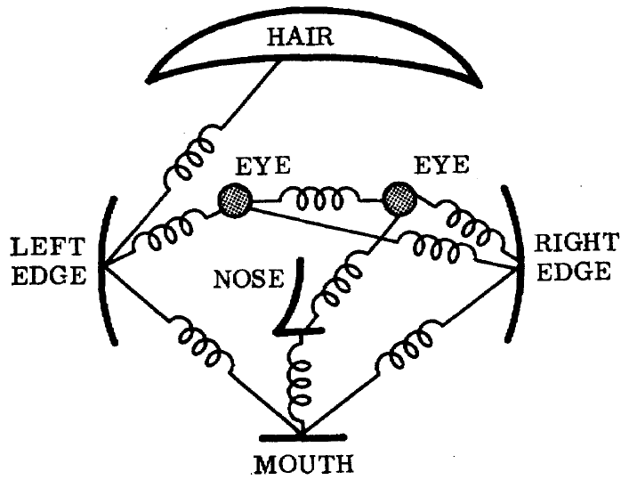
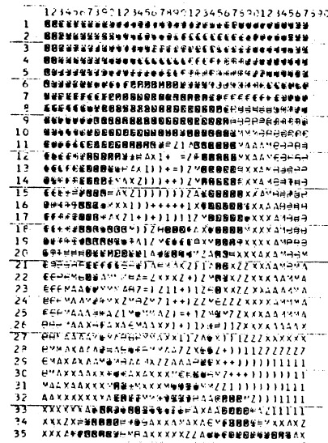
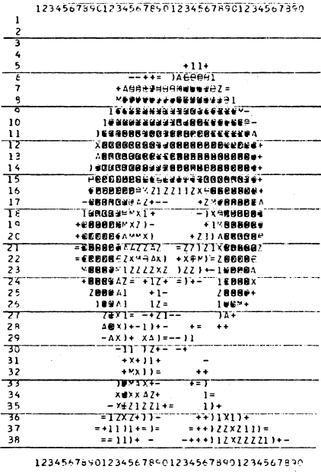
1973
The representation and matching of pictorial structures, Fischler and Elschlager, 1973

Slide 4
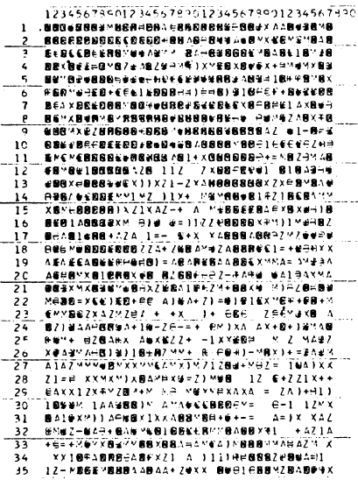
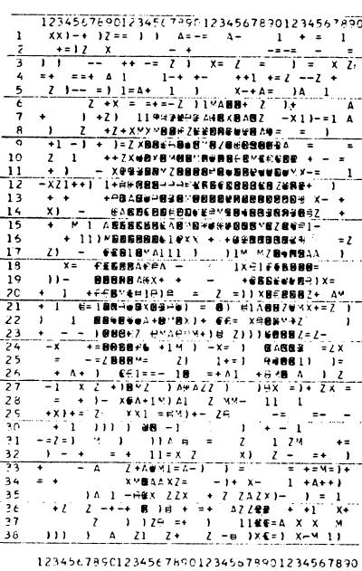
1973

Slide 5
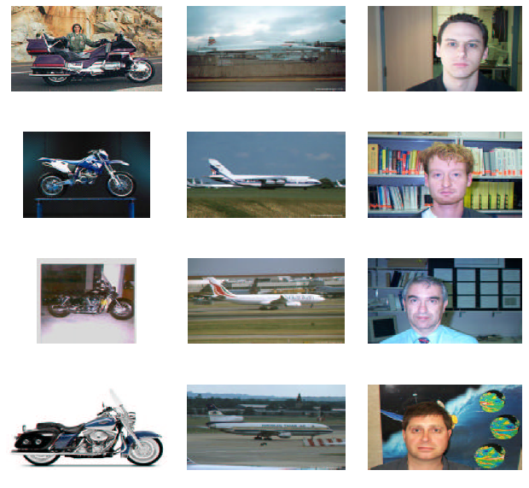
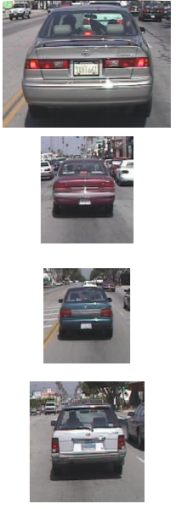
2003
Object Class Recognition by Unsupervised Scale-Invariant Learning, Fergus et al., CVPR 2003.

Slide 6
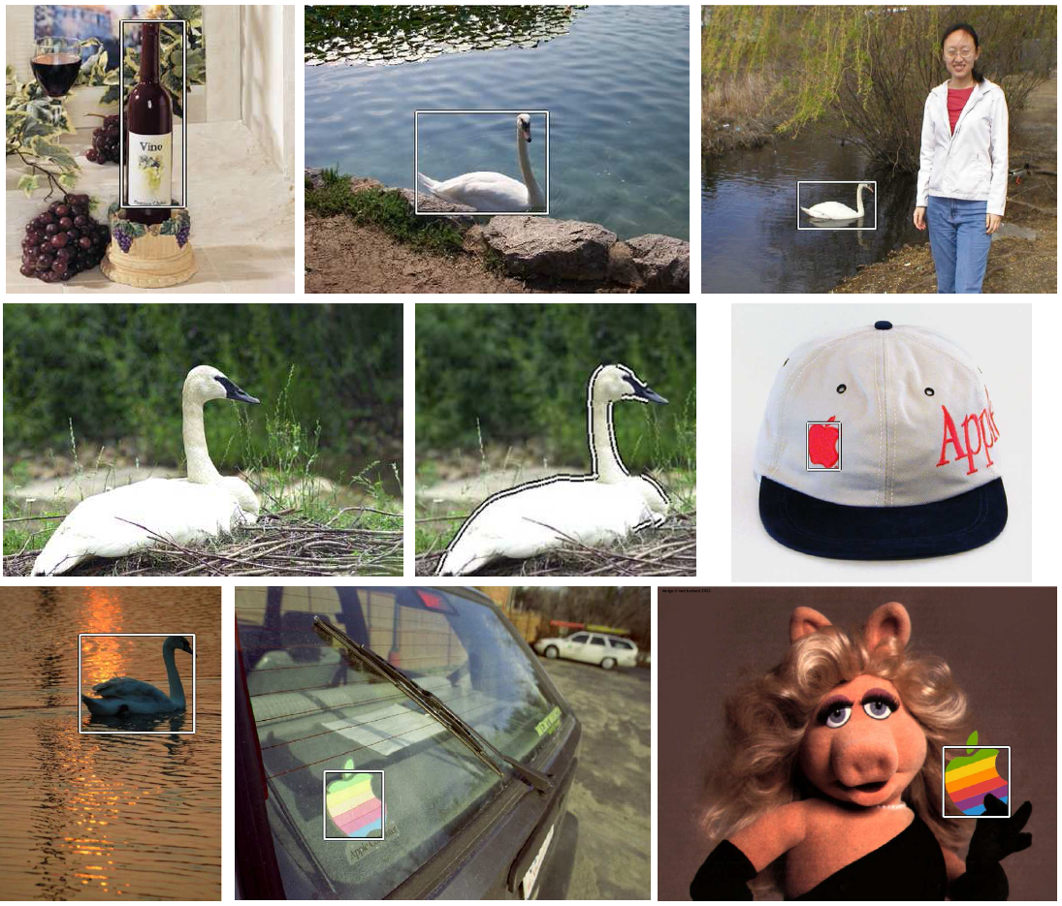
ETHZ Shape Classes
Object Detection by Contour Segment Networks
Ferrari et al., ECCV, 2006.

Slide 7
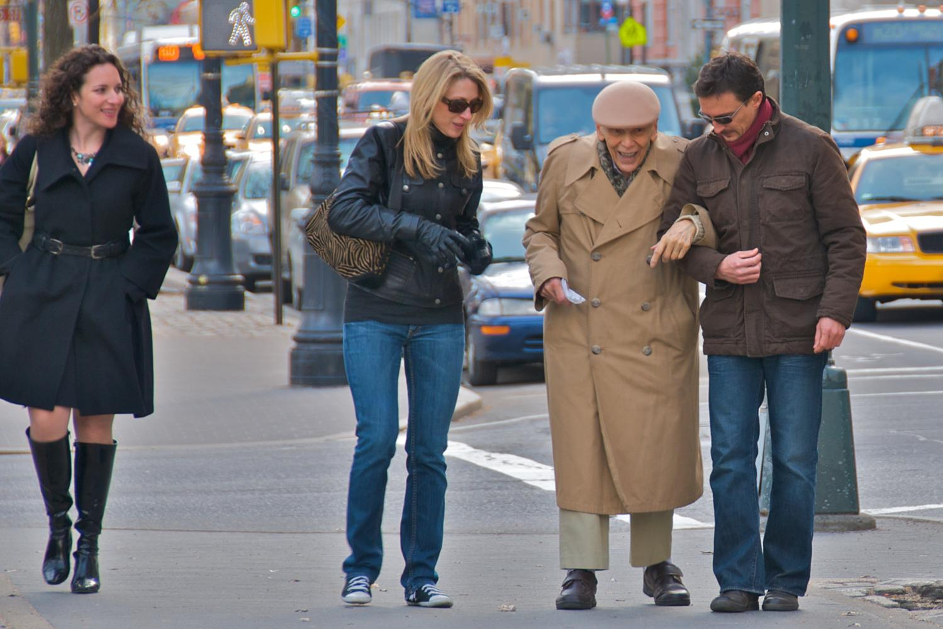
INRIA Person Dataset
Histograms of oriented gradients for human detection, Dalal and Triggs, CVPR 2005.

Slide 8
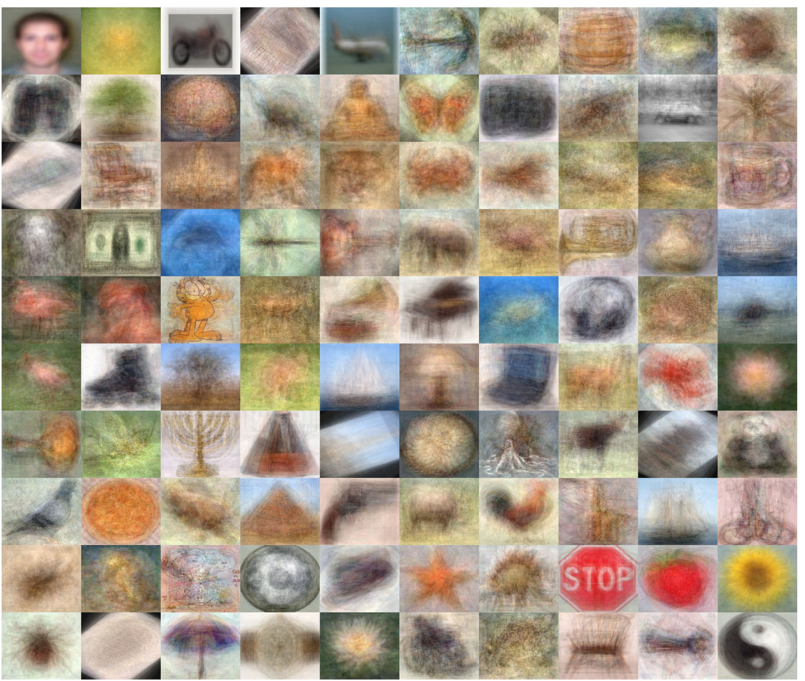
Caltech 101
Antonio Torralba

Slide 9
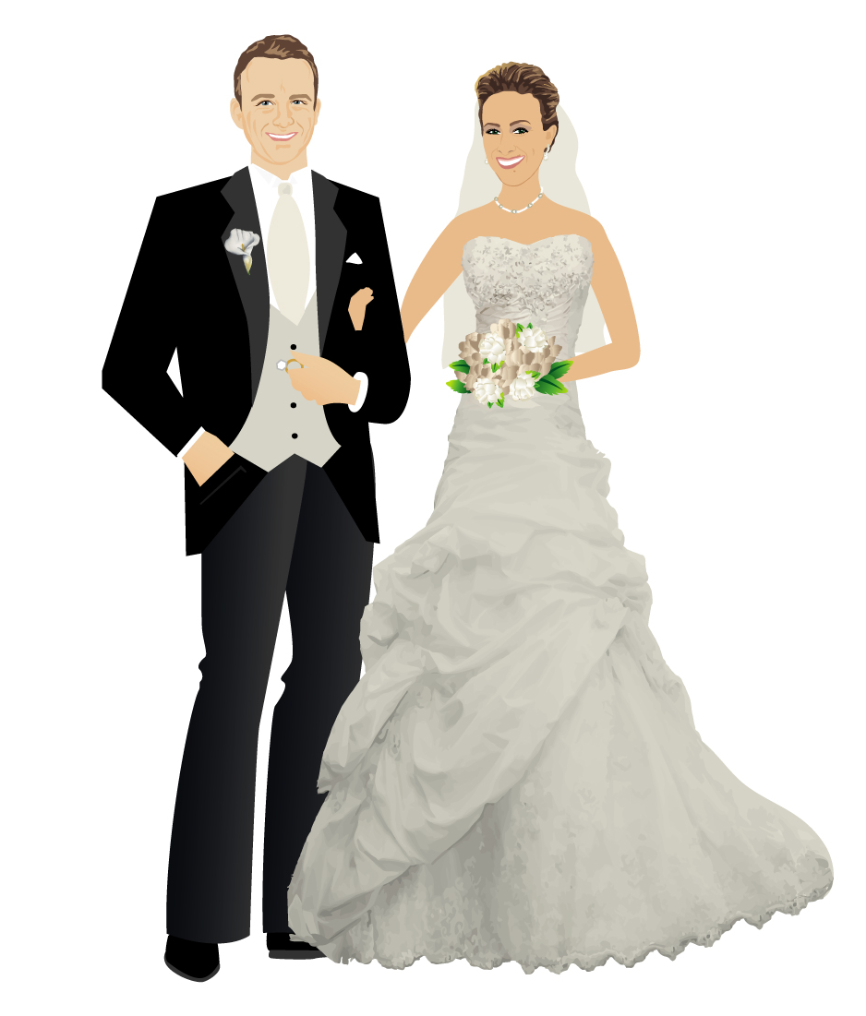
Algorithm
Dataset
How to write a paper:
1. Come up with algorithm.
2. Find/create dataset that works.

Slide 10
Algorithm
Dataset
How to create a dataset:
1. Come up with algorithm.
2. Create a dataset for which the algorithm achieves 50%-80% accuracy.

Slide 11
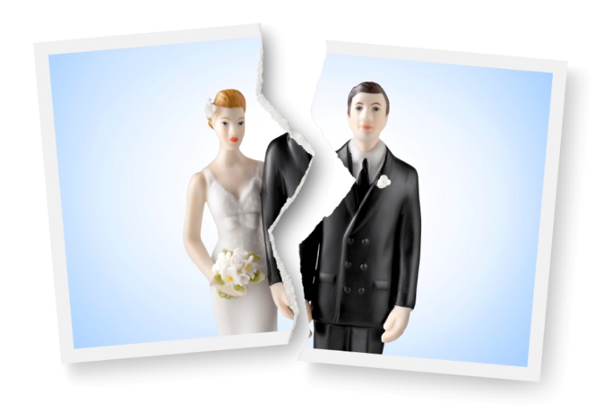
The beginning of a new era…

Slide 12
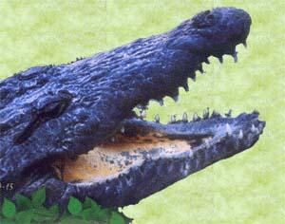
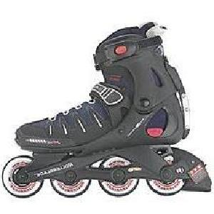
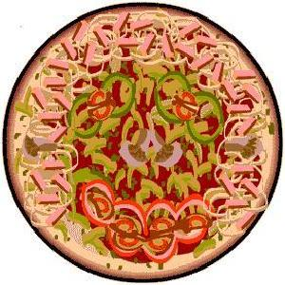
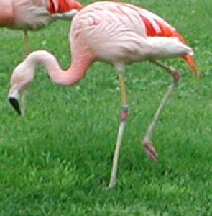
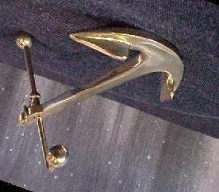
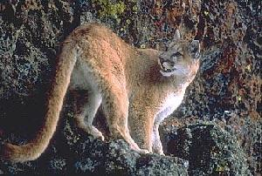
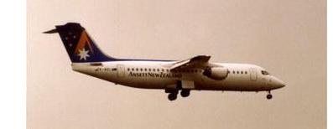
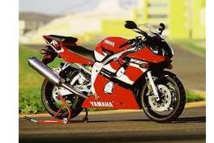
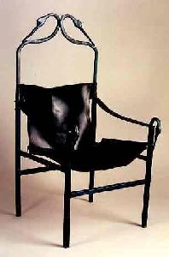
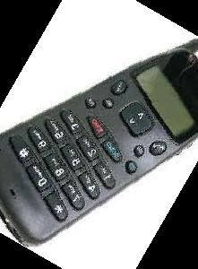
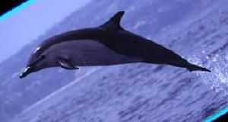
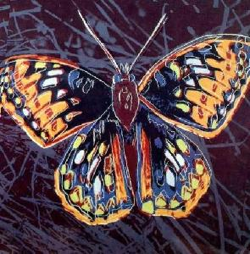
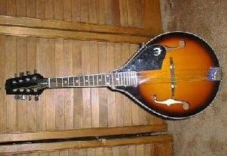
Caltech 101 and 256

Slide 13
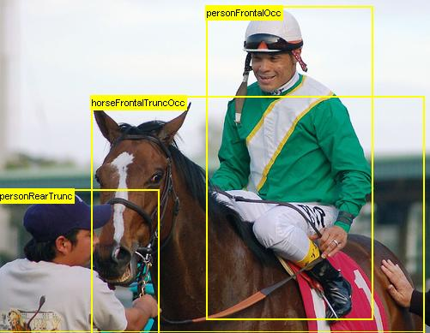
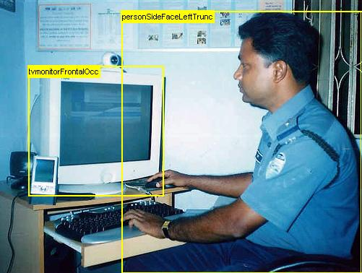
PASCAL VOC
20 classes
30,000 images
The PASCAL Visual Object Classes (VOC) Challenge, Everingham, Van Gool, Williams, Winn and Zisserman, IJCV, 2010

Slide 14
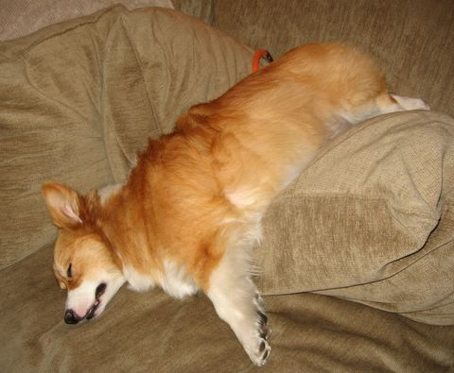
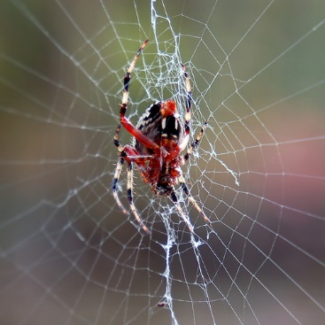
ImageNet “the great enabler”
22K categories, 14M images
Corgi
Orb weaving spider
ImageNet: A Large-Scale Hierarchical Image Database, Deng, Dong, Socher, Li, Li and Fei-Fei, CVPR, 2009

Slide 15
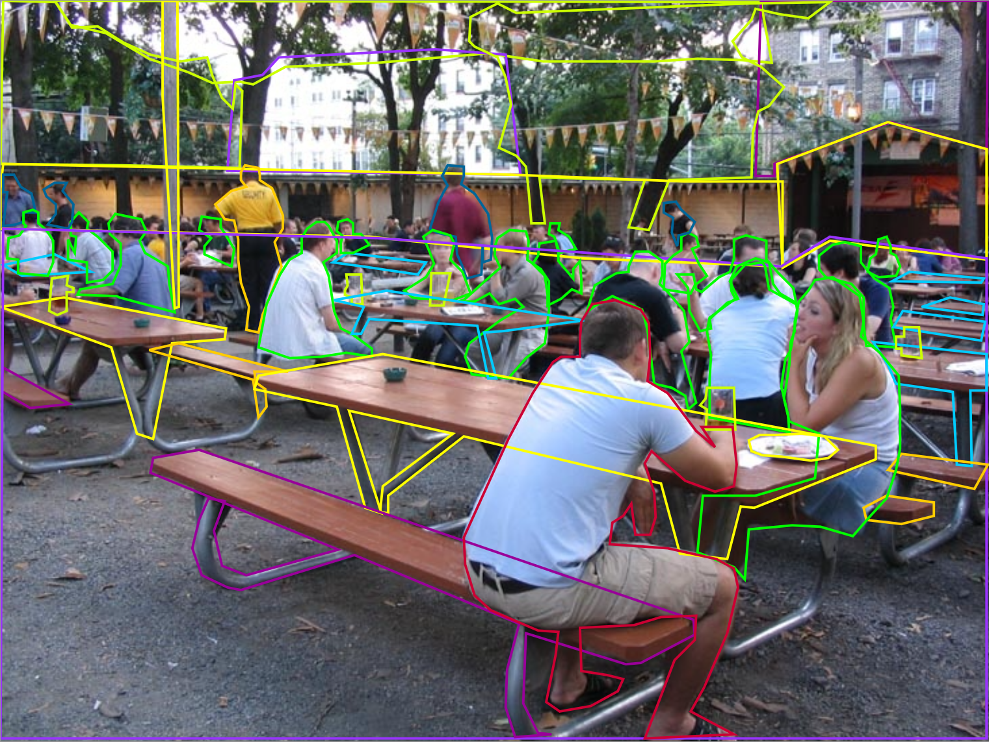
SUN
908 scene categories
Beer garden
SUN Database: Large-scale Scene Recognition from Abbey to Zoo Xiao, Hays, Ehinger, Oliva, and Torralba, CVPR, 2010.

Slide 16
70-100 object categories
330,000 images (~150k first release)

Slide 17
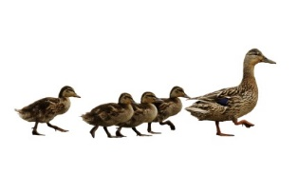
How to write a paper:
1. Pick a dataset.
2. Find an algorithm that works.
Dataset
Algorithms

Slide 18
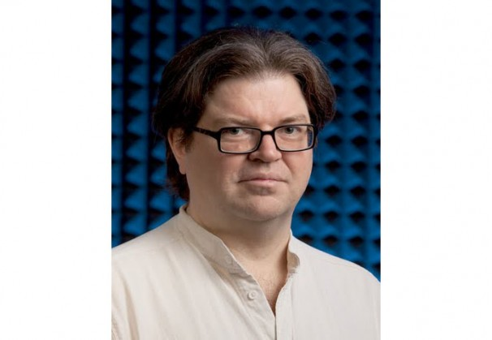
Caltech 101 and 256
15 or 30 training examples per category
Hand coded features =

Slide 19
How to create a dataset:
1. Pick a problem.
2. Create a challenging LARGE dataset.
Dataset
Algorithms

Slide 20
What is the consequence?

Slide 21
Large = Expensive
Expensive = Scarce
Scarce = Valuable*
*Increased stakes = Increased “cheating”

Slide 22
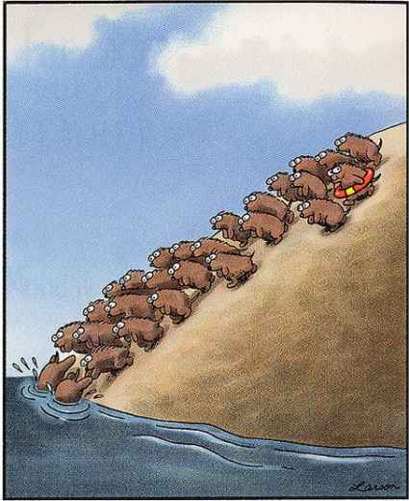
Scarce = Few

Slide 23
Diversity
Diagnosing Error in Object Detectors Hoiem et al., ECCV, 2012

Slide 24
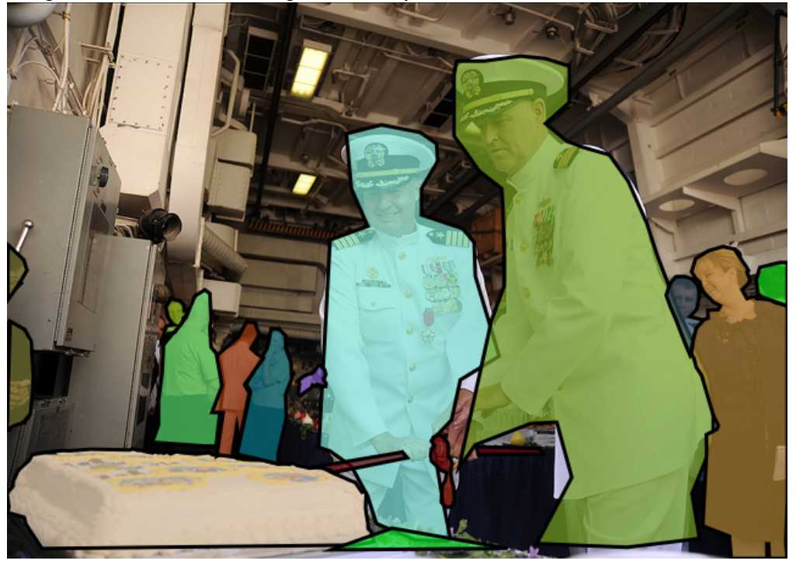
Diversity
Ship

Slide 25
Image Captions

Slide 26
80-100 object categories
330k images (Flickr)
2M+ instances (700k people)
Every instance segmented
http://mscoco.org
Notes:
Mention 35,000 hours.
Which we will have 330 images labeled and keypoints annotations.

Slide 27
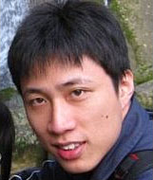
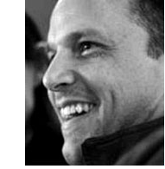
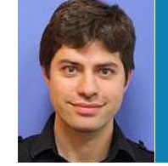
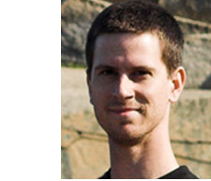
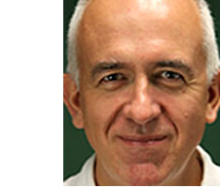
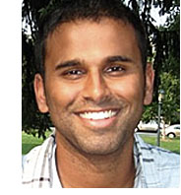
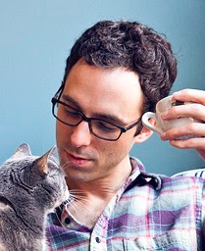
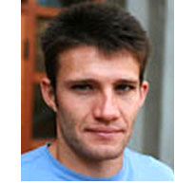
Tsung-Yi Lin
Michael Maire
Serge Belongie
Lubomir Bourdev
James Hays
TTI Chicago
Cornell Tech
Facebook
Brown University
Cornell Tech
Pietro Perona
Deva Ramanan
Ross Girshick
Piotr Dollar
Larry Zitnick
Caltech
UC Irvine
Microsoft Research
Facebook
Microsoft Research
Notes:
I am happy to introduce the microsoft coco dataset today.
That is generously funded by Microsoft.
While it is funded by microsoft, I would like to stress (pause) this dataset is made by academics (pause) and made for academics (pause).
And the license for the annotations is under simplified BSD so there is no restriction for commercial use.
We would like to thank Microsoft for generously funding the dataset. Though the dataset is funded by company, it is made for academic and by academic. Here you might see some familiar faces from people behind COCO.

Slide 28
Timeline
August, 2014
120,000 images x 5 captions per image =
600,000 captions

Slide 29
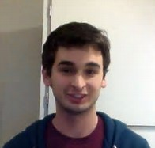
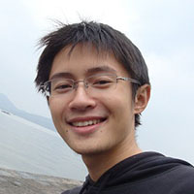
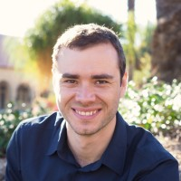
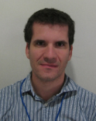
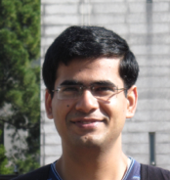
The Great Freak Out
August, 2014
October
Yeesss!
It works!!!
I can’t believe it works!!!
Sweet!!!
This is awesome!!!

Slide 30
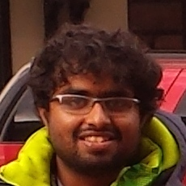
Hao Fang
Tsung-Yi Lin
Xinlei Chen
Rama Vedantam
UW
Cornell Tech
CMU
VT
Evaluation server = Hidden GT test data
Notes:
I am happy to introduce the microsoft coco dataset today.
That is generously funded by Microsoft.
While it is funded by microsoft, I would like to stress (pause) this dataset is made by academics (pause) and made for academics (pause).
And the license for the annotations is under simplified BSD so there is no restriction for commercial use.
We would like to thank Microsoft for generously funding the dataset. Though the dataset is funded by company, it is made for academic and by academic. Here you might see some familiar faces from people behind COCO.

Slide 31
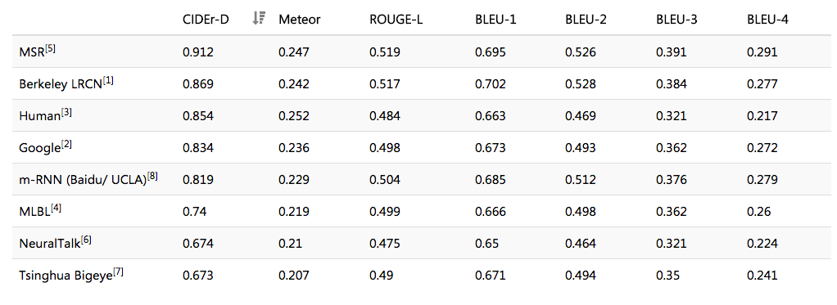
The Reckoning
August, 2014
October
April, 2015

Slide 32
Advisors:
Tamara Berg
Piotr Dollar
Desmond Elliott
Julia Hockenmaier
Meg Mitchell
Devi Parikh
Larry Zitnick
Matteo Ronchi
Yin Cui
Tsung-Yi Lin
Caltech
Cornell
Cornell Tech
Notes:
I am happy to introduce the microsoft coco dataset today.
That is generously funded by Microsoft.
While it is funded by microsoft, I would like to stress (pause) this dataset is made by academics (pause) and made for academics (pause).
And the license for the annotations is under simplified BSD so there is no restriction for commercial use.
We would like to thank Microsoft for generously funding the dataset. Though the dataset is funded by company, it is made for academic and by academic. Here you might see some familiar faces from people behind COCO.

Slide 33
The Enlightening
August, 2014
October
April
June, 2015
 | M1 | M2 | M3 | M4 | M5
Human^{[5]} | 0.638 | 0.675 | 4.836 | 3.428 | 0.293
Google^{[4]} | 0.273 | 0.317 | 4.107 | 2.742 | 0.100
MSR^{[8]} | 0.268 | 0.322 | 4.137 | 2.662 | 0.108
Montreal/Toronto^{[10]} | 0.262 | 0.272 | 3.932 | 2.832 | 0.086
MSR Captivator^{[9]} | 0.250 | 0.301 | 4.149 | 2.565 | 0.092
Berkeley LRCN^{[2]} | 0.246 | 0.268 | 3.924 | 2.786 | 0.086
m-RNN^{[15]} | 0.223 | 0.252 | 3.897 | 2.595 | 0.074
Nearest Neighbor^{[11]} | 0.216 | 0.255 | 3.801 | 2.716 | 0.083
PicSOM^{[13]} | 0.202 | 0.250 | 3.965 | 2.552 | 0.073
Brno University^{[3]} | 0.194 | 0.213 | 3.079 | 3.482 | 0.085
m-RNN (Baidu/ UCLA)^{[16]} | 0.190 | 0.241 | 3.831 | 2.548 | 0.072
MIL^{[6]} | 0.168 | 0.197 | 3.349 | 2.915 | 0.067
MLBL^{[7]} | 0.167 | 0.196 | 3.659 | 2.420 | 0.056
NeuralTalk^{[12]} | 0.166 | 0.192 | 3.436 | 2.742 | 0.059
ACVT^{[1]} | 0.154 | 0.190 | 3.516 | 2.599 | 0.060
Tsinghua Bigeye^{[14]} | 0.100 | 0.146 | 3.510 | 2.163 | 0.045

Slide 34
Evaluation Metrics

Slide 35
Evaluation Metrics
Human captions

Slide 36
Evaluation Metrics
Brno University

Slide 37
Baselines

Slide 38
A man riding a wave on a surfboard in the water.

Slide 39
A man riding a wave on a surfboard in the water.
“surfboard”

Slide 40
A man walking his dog in the park.

Slide 41
A man walking his dog in the park.
“dog”

Slide 42
Baselines
Nearest neighbor
Exploring Nearest Neighbor Approaches for Image Captioning, Devlin et al., ArXiv, May 2015

Slide 44
vemödalen - n. the fear that our datasets will never have the diversity we desire
vemödalen - n. the frustration of photographing something amazing when thousands of identical photos already exist
Vemödalen: The Fear That Everything Has Already Been Done
https://www.youtube.com/watch?v=8ftDjebw8aA

Slide 45
A crazy zebra climbing a giraffe to get a better view.

Slide 46
A man is rescued from his truck that is hanging dangerously from a bridge.
Virginia M. Schau

Slide 47
The Future…
Semantics
CV
AI

Slide 48
VQA: Visual Question Answering
VQA: Visual Question Answering
Antol et al., ArXiv, 2015.

Slide 49
VQA: Visual Question Answering

Slide 51
VQA: Visual Question Answering
Release dates
June 5th 2015 (Sample release)
10k images from COCO train
30k questions (3 per image)
300k answers (10 per question)
Evaluation code
Helper code to parse the data
July 2015 (Beta release)
100k images
September 2015 (Full release)
120k COCO train+val images
An additional val set containing 60k “random” images from Flickr (not in COCO) to increase dataset diversity and to test generalization
50k abstract scenes to help focus on the higher level reasoning behind VQA

Slide 52
Lessons
Diversity is essential
Label diversity = research diversity
Nearest neighbor != solved
Increased stakes = increased “cheating”
Test servers (Codalab.org)
Baselines are critical for understanding datasets
Understanding algorithms = understanding data
Need to recognize the tradeoffs
Generalization != important
Video != important

Slide 53
Yet, another dataset paper…
…sometimes asking the right question is more important than the answer.

