Slide 2
Finding Common Sense
Larry Zitnick
Senior Researcher
Microsoft Research

Slide 3
Common sense
“Sound practical judgment derived from experience rather than study.”

Slide 4
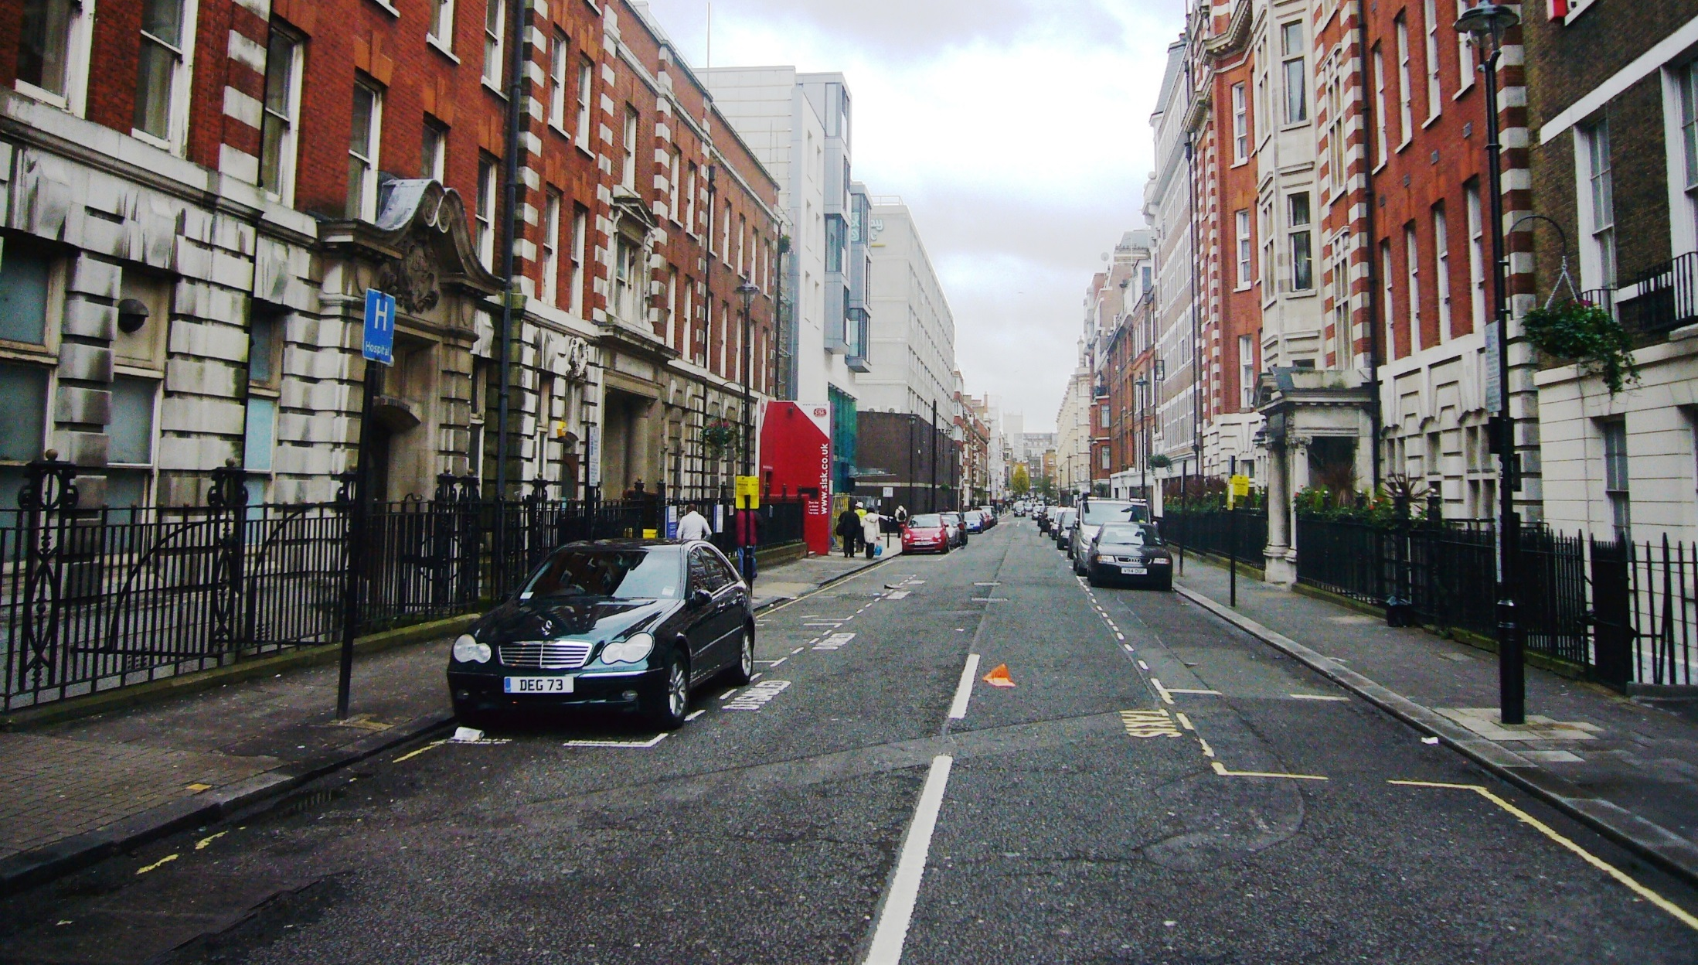
Context

Slide 5
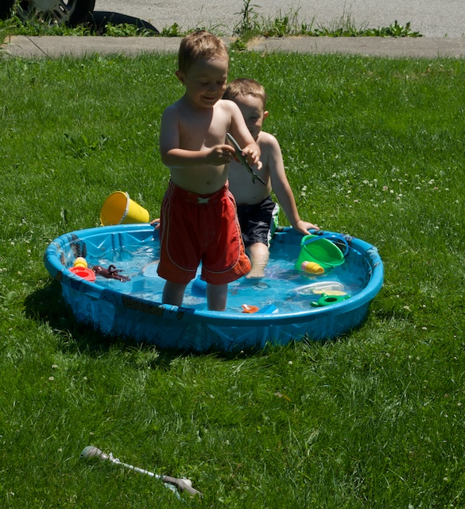
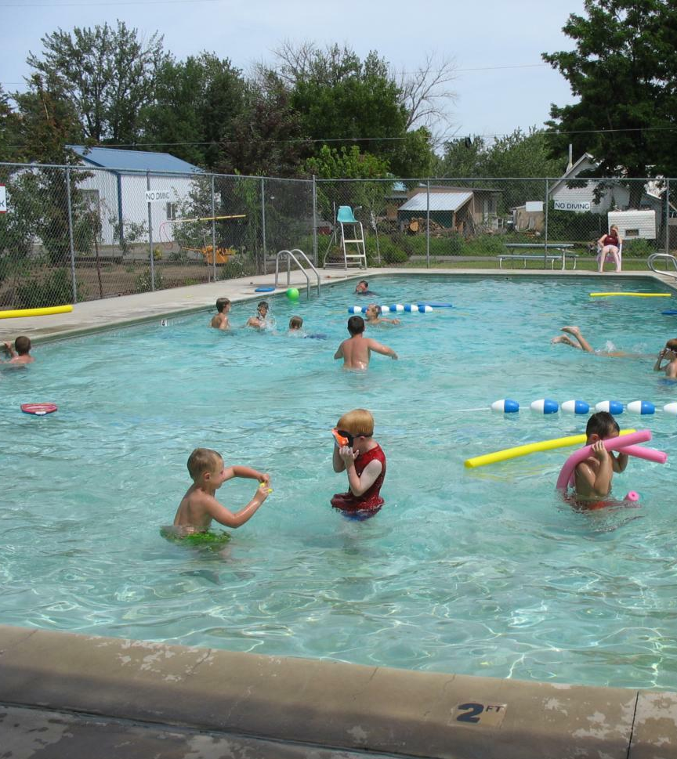
Attributes
Diving?

Slide 6
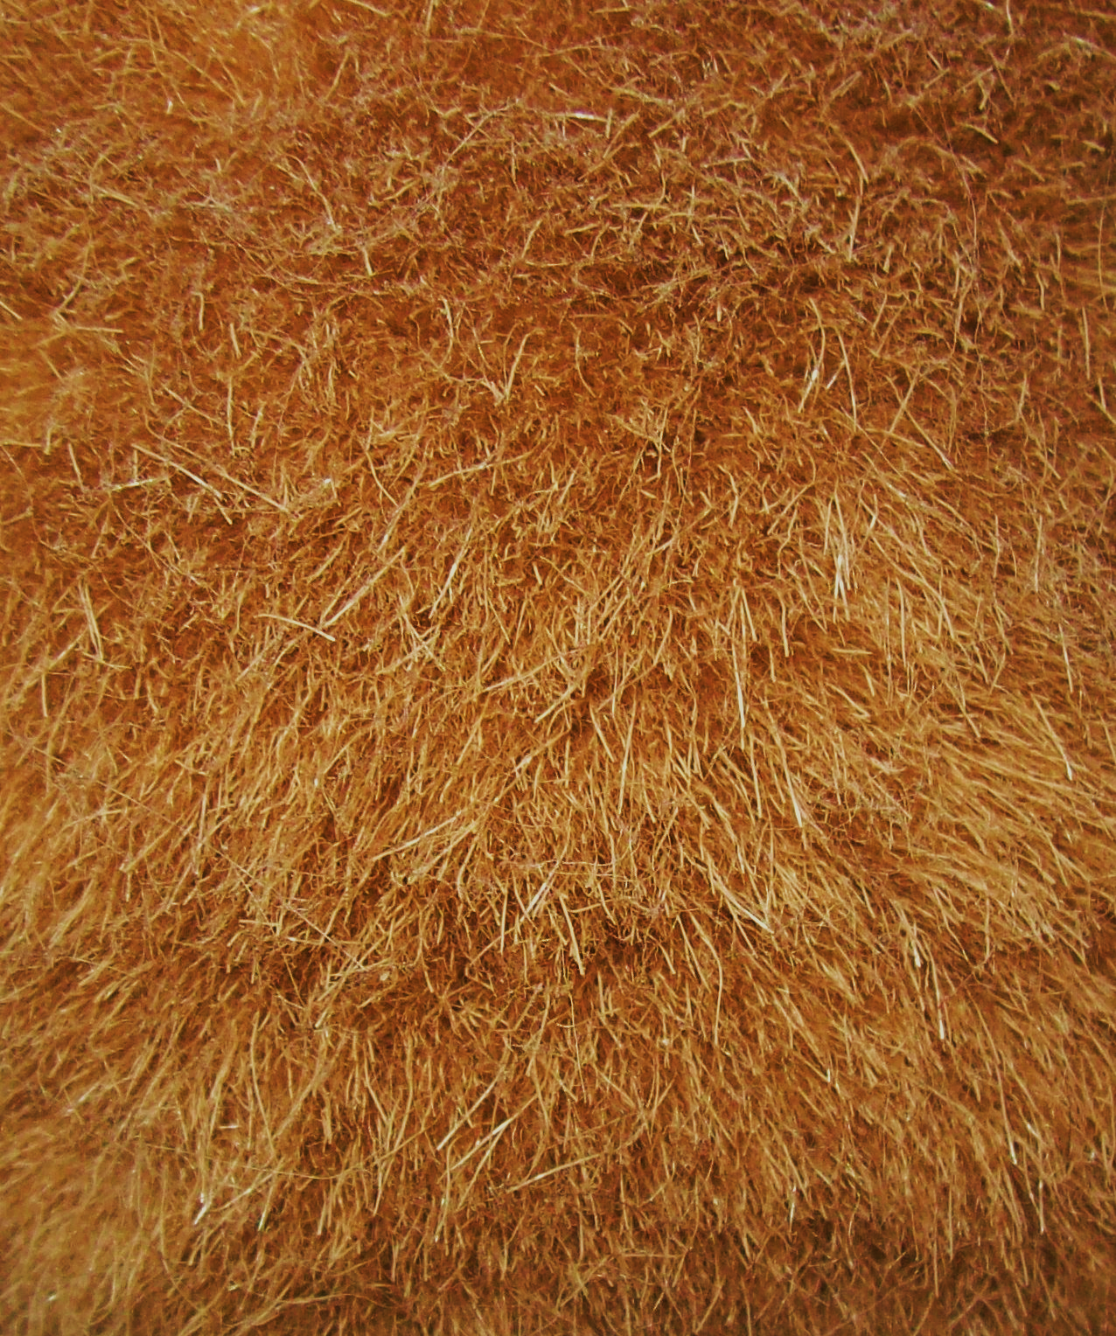
Rough
Furry

Slide 7
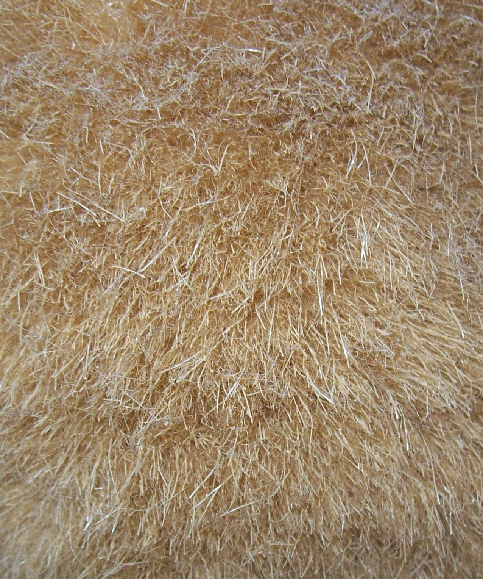
Furry
Rough

Slide 8
Son of Man, Magritte

Slide 10
What is this man doing?

Slide 11
What is this man doing?

Slide 12
Two birds with funny blue feet.

Slide 13
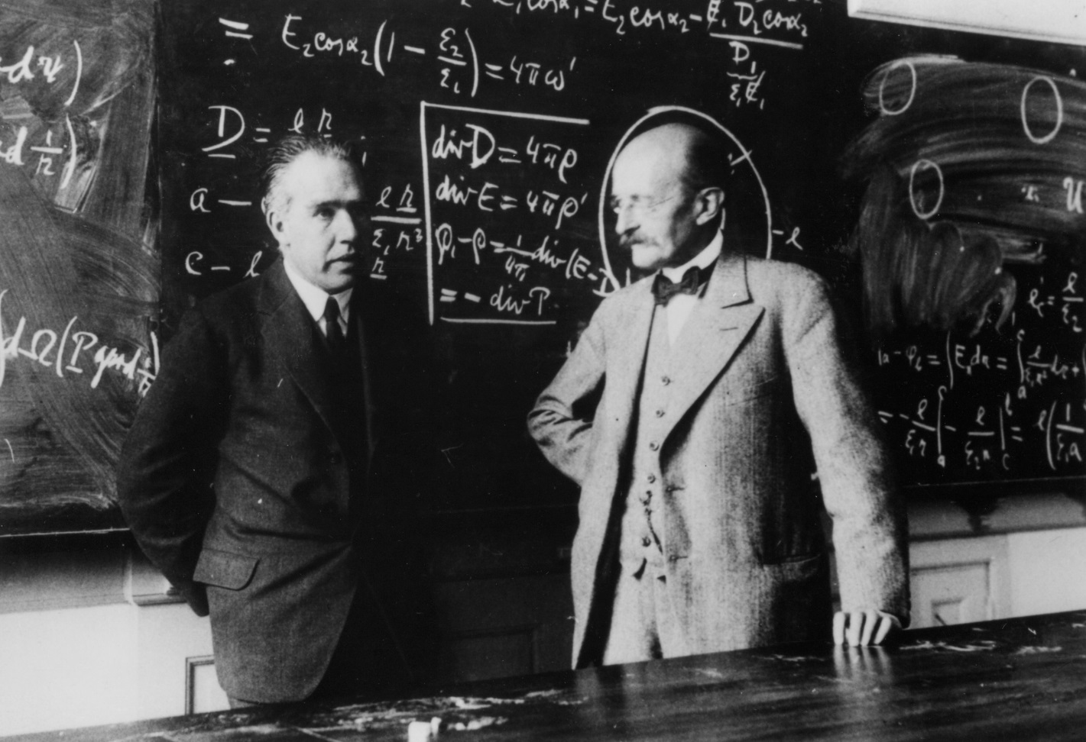
Two professors converse in front of a blackboard.

Slide 14
Semantics
CV
AI

Slide 15
Why is something so common so hard to find?

Slide 16
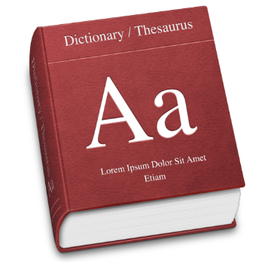
Does a bird fly?
Bird n. feathered animal.
Bird n. any of a class of warm-blooded vertebrates distinguished by having the body more or less completely covered with feathers and the forelimbs modified as wings.
Bird n. two-legged winged animal: a two-legged, warm-blooded animal with wings, a beak, and a body covered with feathers.

Slide 17
Does a bird fly?
Penguin n. seabird that cannot fly.
Penguin n. a large flightless seabird of the southern hemisphere

Slide 18
Does a bird fly?
Birds (class Aves or clade Avialae) are feathered, winged, bipedal, endothermic (warm-blooded), egg-laying, vertebrate animals. With around 10,000 living species, they are the most speciose class of tetrapod vertebrates. All present species belong to the subclass Neornithes, and inhabit ecosystems across the globe, from the Arctic to the Antarctic. Extant birds range in size from the 5 cm (2 in) Bee Hummingbird to the 2.75 m (9 ft) Ostrich. The fossil record indicates that birds emerged within theropod dinosaurs during the Jurassic period, around 150 million years ago. Paleontologists regard birds as the only clade of dinosaurs to have survived the Cretaceous–Paleogene extinction event 66 million years ago.
Modern birds are characterised by feathers, a beak with no teeth, the laying of hard-shelled eggs, a high metabolic rate, a four-chambered heart, and a lightweight but strong skeleton. All living species of birds have wings; the most recent species without wings was the moa, which is generally considered to have become extinct in the 16th century. Wings are evolved forelimbs, and most bird species can fly. Flightless birds include ratites, penguins, and a number of diverse endemic island species. Birds also have unique digestive and respiratory systems that are highly adapted for flight. Some birds, especially corvids and parrots, are among the most intelligent animal species; a number of bird species have been observed manufacturing and using tools, and many social species exhibit cultural transmission of knowledge across generations.

Slide 19
Web search

Slide 20
Cyc
Started in 1984, Doug Lenat
7 million assertions (common sense knowledge)
Both manually and automatically added
(#$isa #$Bird #$FlyingAnimal)

Slide 21
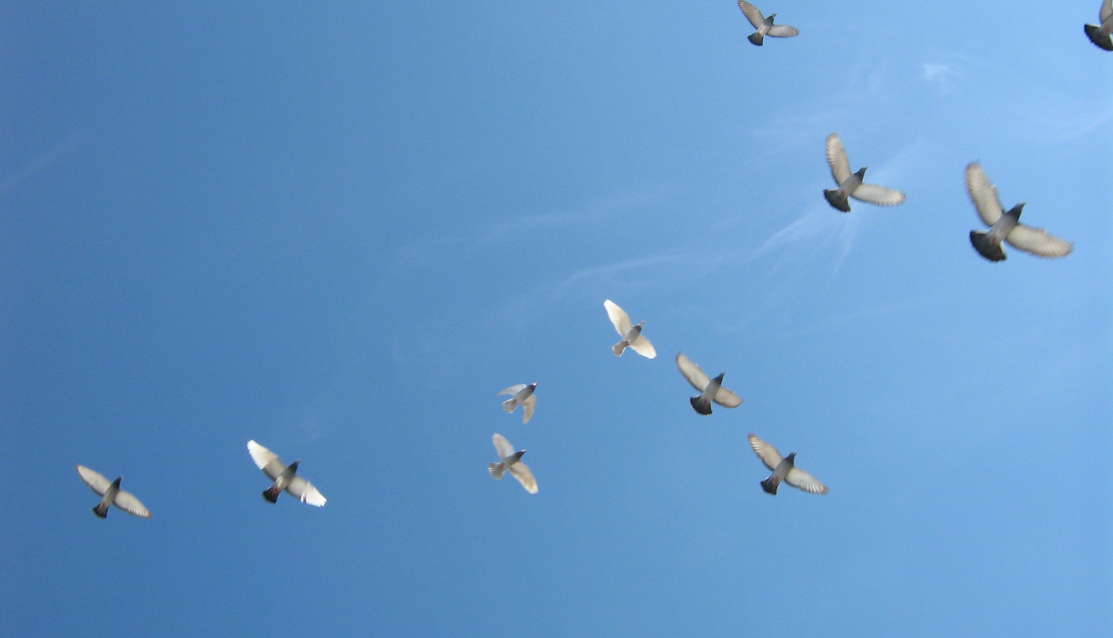
How do we know birds fly?

Slide 22
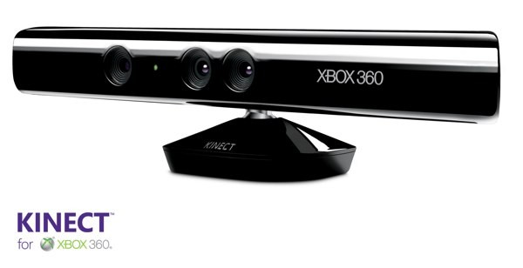
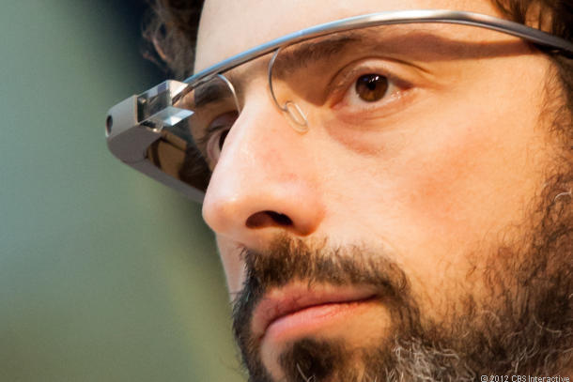
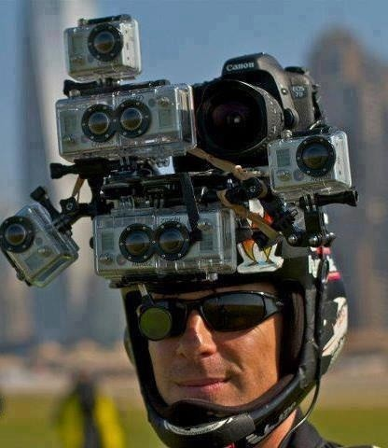
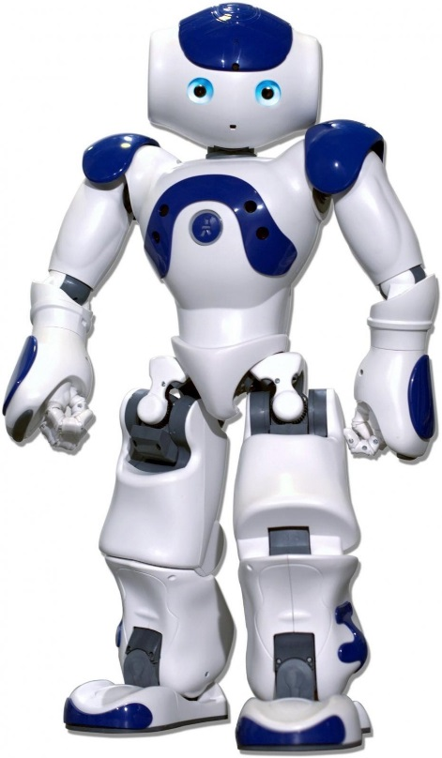

Slide 23
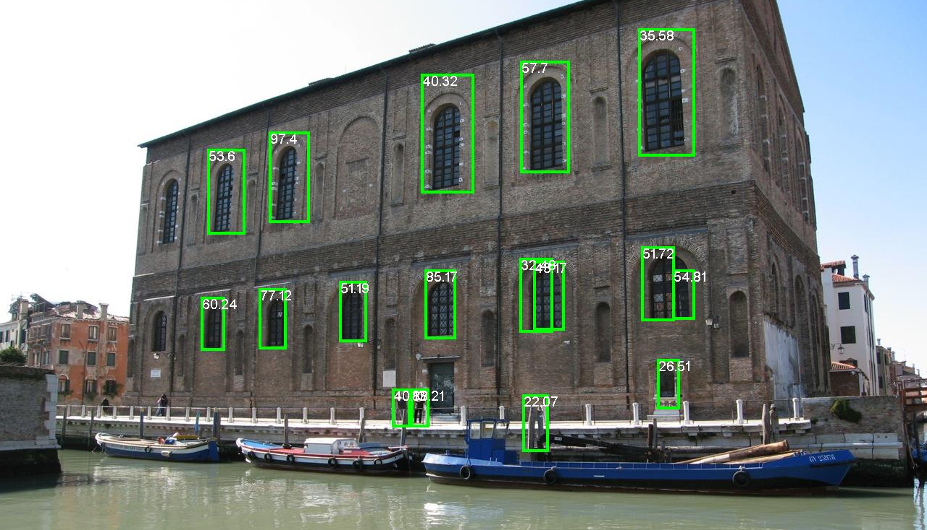
Person detections
Dollar et al., BMVC 2009

Slide 24
Apparent Behavior, Heider and Simmel, 1944

Slide 25
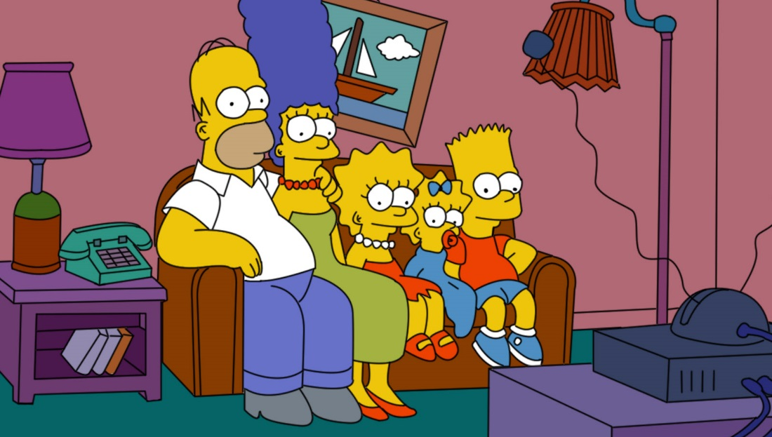

Slide 26
Jenny
Mike

Slide 28
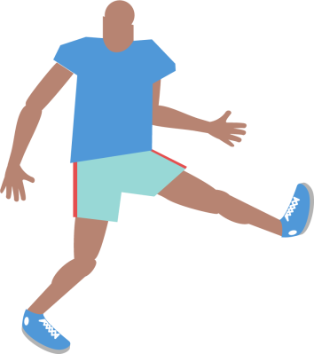
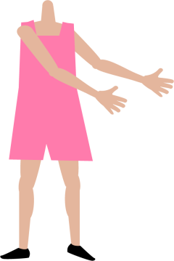
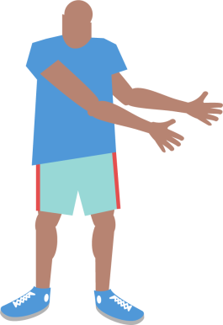

Slide 29
How do we generate scenes?

Slide 30
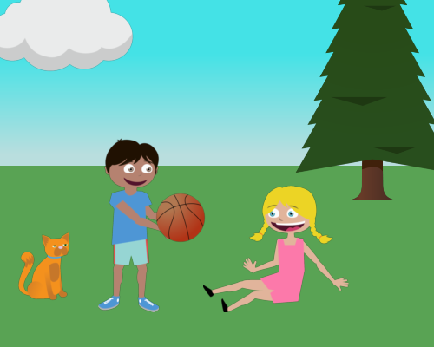
Visual features

Slide 31
Visual features
Cloud
Tree
Gaze
Smile
Gaze
Cat
Basketball
Person standing
Person sitting

Slide 32
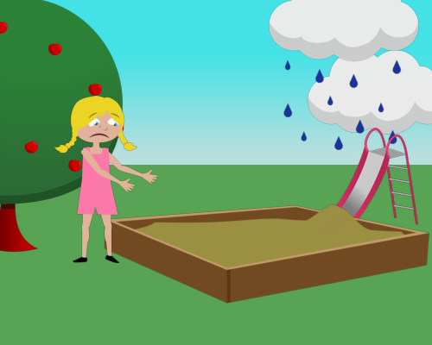
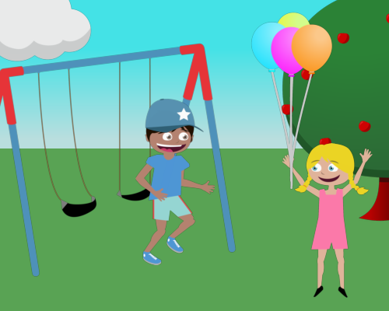
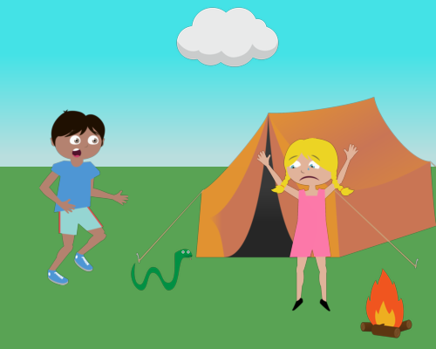

Slide 33
Generating sentences
Jenny loves to play soccer but she is worried that Mike will kick the ball too hard.
Mike and Jenny play outside in the sandbox. Mike is afraid of an owl that is in the tree.

Slide 34
Previous work
Sentence generation
Farhadi et al., Every picture tells a story: Generating sentences from images. ECCV, 2010.
Ordonez et al., Im2text: Describing images using 1 million captioned photographs. NIPS, 2011.
Yang et al., Corpus-guided sentence generation of natural images. EMNLP, 2011.
Kulkarni et al., Baby talk: Understanding and generating simple image descriptions. CVPR, 2011.
Kuznetsova et al., Collective Generation of Natural Image Descriptions. ACL, 2012.
Gupta et al., Choosing Linguistics over Vision to Describe Images. AAAI, 2012.
Mitchell et al., Midge: Generating Image Descriptions From Computer Vision Detections. EACL, 2012.
Nouns
Spain and Perona, Measuring and predicting object importance. IJCV 2011.
Hwang and Grauman, Learning the relative importance of objects… IJCV, 2011.
Adjectives, prepositions
Gupta and Davis, Beyond nouns …, ECCV, 2008.
Farhadi et al., Describing objects by their attributes. CVPR, 2009.
Berg et al., Automatic attribute discovery and characterization from noisy web data. ECCV 2010.
Parikh and Grauman. Relative attributes. ICCV 2011.
Verbs
Yao and Fei-Fei, Modeling mutual context … in human-object interaction activities. CVPR 2010.
Sadeghi and Farhadi, Recognition using visual phrases. CVPR 2011.

Slide 35
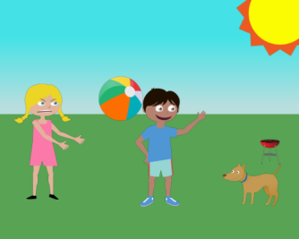
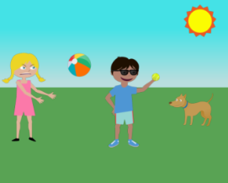
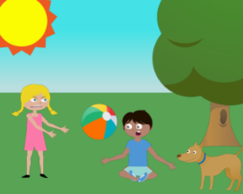
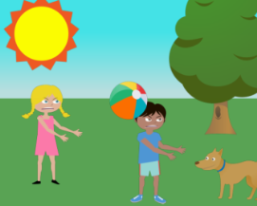
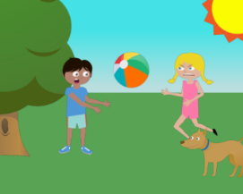
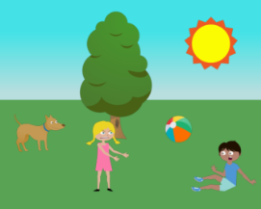
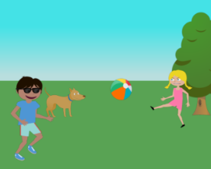
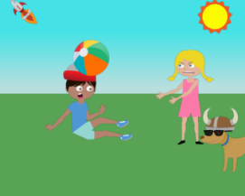
Generating data
“Jenny just threw the beach ball angrily at Mike while the dog watches them both.”
Zitnick and Parikh, CVPR 2013

Slide 36
Mike fights off a bear by giving him a hotdog while jenny runs away.

Slide 37
It was raining in the park and a duck and a snake were trying to take shelter.

Slide 38
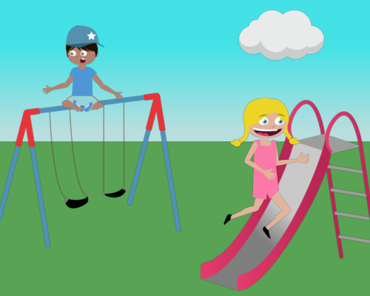
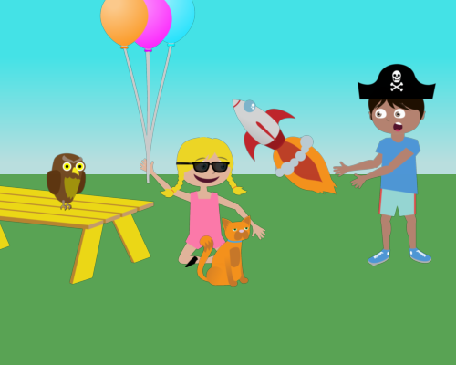
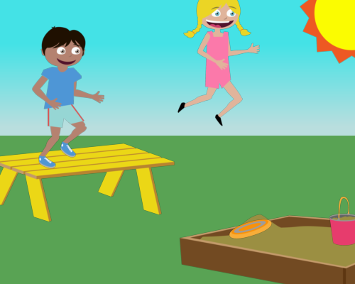
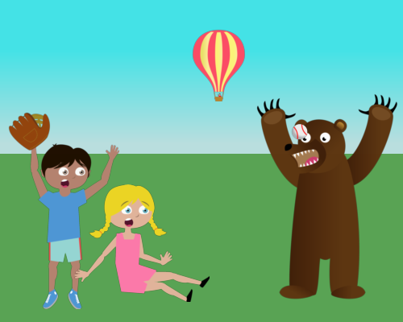
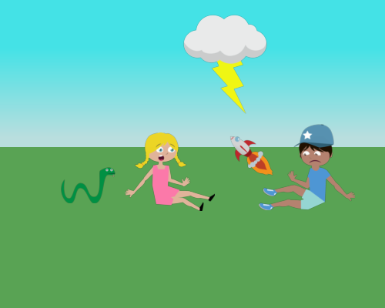
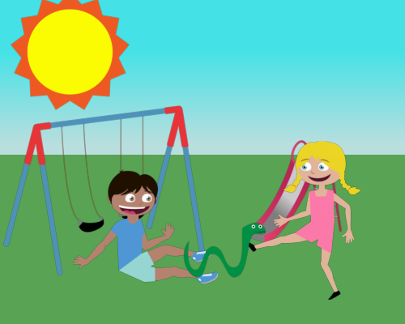
Jenny and Mike are both playing dangerously in the park.

Slide 39
Object occurrence
High
Low
Mutual Information
Mutual Information
Zitnick and Parikh, CVPR 2013

Slide 40
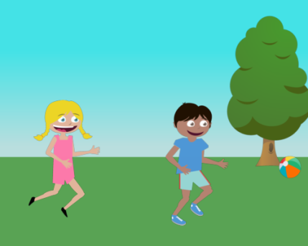
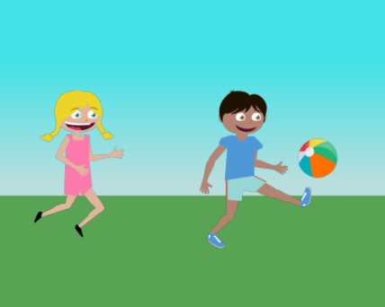
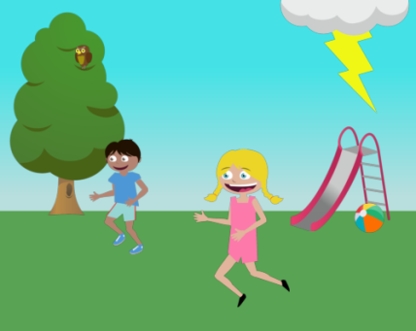
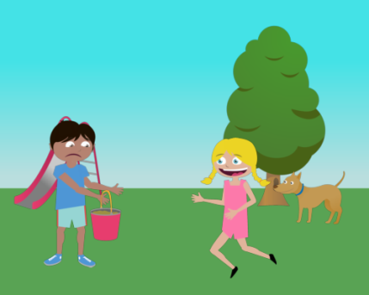
Semantic meaning
Jenny is next to Mike.
Jenny ran after Mike.
Jenny ran to Mike.

Slide 41
run away from
chase
run towards
run to

Slide 42
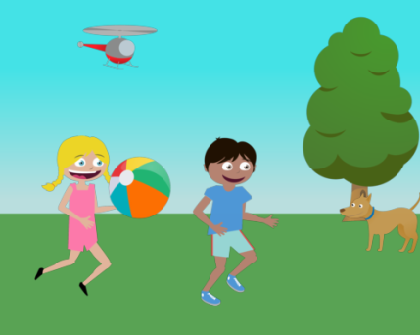
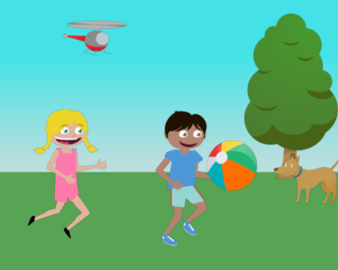
Jenny ran after Mike with a ball.

Slide 43
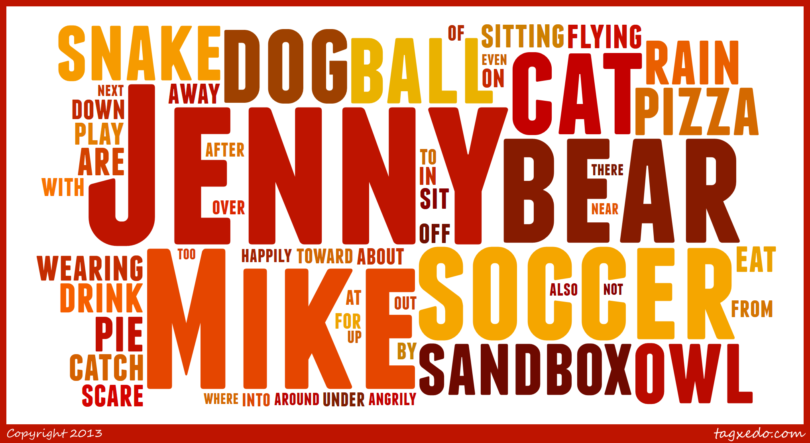
Most visually informative words
Zitnick and Parikh, CVPR 2013

Slide 44
Least visually informative words
today
home
me
something
attention
using
isn’t
doing
went
give
behind
before
during
onto
through
how
since
why
finally
almost

Slide 45
Stories

Slide 46
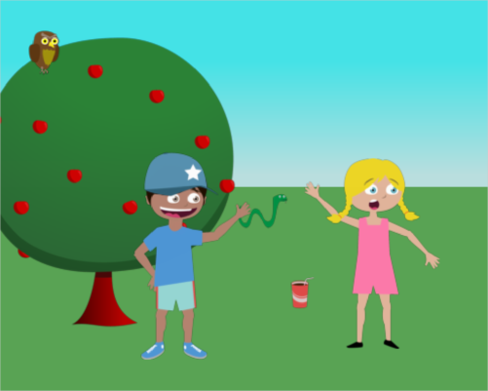
Stories

Slide 47
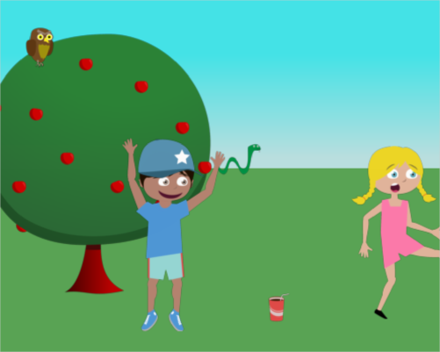
Stories

Slide 48
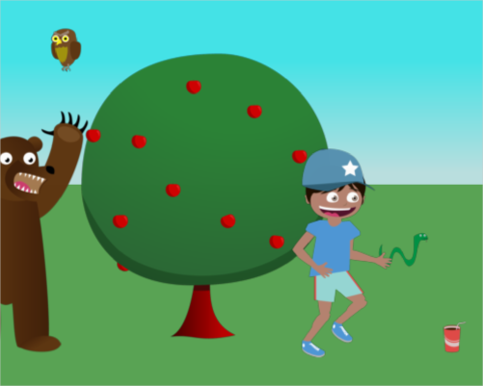
Stories

Slide 49
Stories

Slide 50
Fun?
After these gems, I am going back to Mike and Jenny. I might be only making $5 an hour, but at least I will have fun doing it.
WOW, these are insanely entertaining after 8 solid hours of turking.
I'm going to miss these HITs when they are gone. Completely no value to the hour, but so much fun.
That was fun, but I can't make any money on these, too much time spent arranging the scenes..haha.

Slide 51
Realism?

Slide 52
3D?

Slide 53
Relevant?

Slide 54
New approach to learning
“common sense” knowledge about our world.
Don’t wait for object recognition to be solved.
Thanks!
Devi Parikh
Virginia Tech
Lucy Vanderwende
Microsoft Research

Slide 55
© 2013 Microsoft Corporation. All rights reserved. Microsoft, Windows and other product names are or may be registered trademarks and/or trademarks in the U.S. and/or other countries.
The information herein is for informational purposes only and represents the current view of Microsoft Corporation as of the date of this presentation. Because Microsoft must respond to changing market conditions, it should not be interpreted to be a commitment on the part of Microsoft, and Microsoft cannot guarantee the accuracy of any information provided after the date of this presentation. MICROSOFT MAKES NO WARRANTIES, EXPRESS, IMPLIED OR STATUTORY, AS TO THE INFORMATION IN THIS PRESENTATION.

