Slide 1
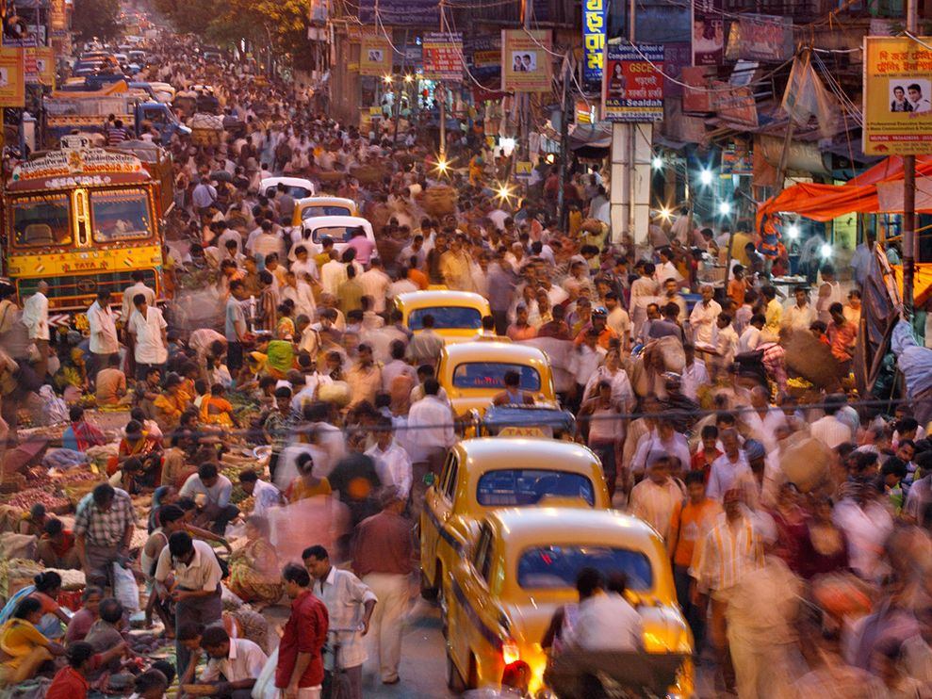
Object recognition
Larry Zitnick
Microsoft Research

Slide 2
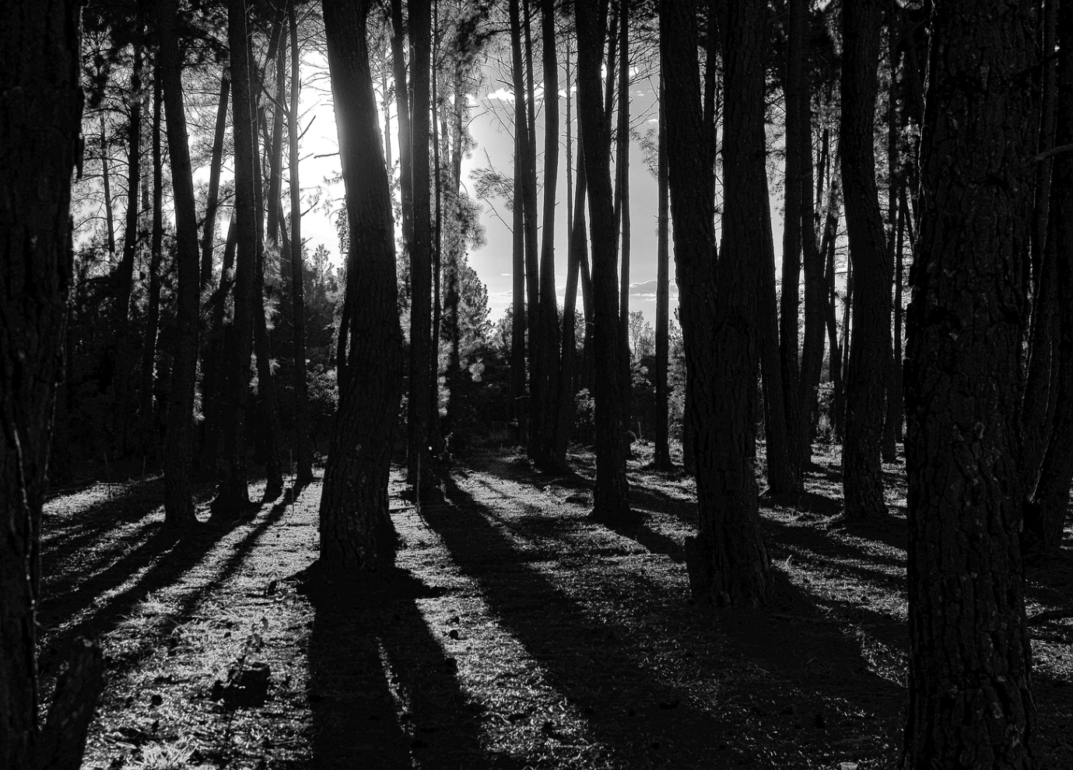
Motivation
How did we get here?
Where are we now?

Slide 3
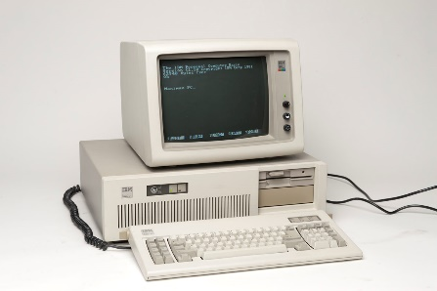
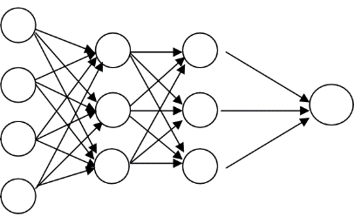
Goals
45 min: History object recognition
Why it works, why it fails!
15+ min: Current status
Will deep neural networks solve it all?

Slide 4
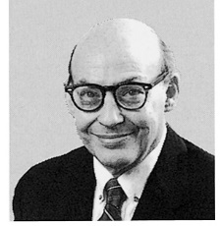
1966
“Connect a television camera to a computer and get the machine to describe what it sees.”
Marvin Minsky

Slide 5
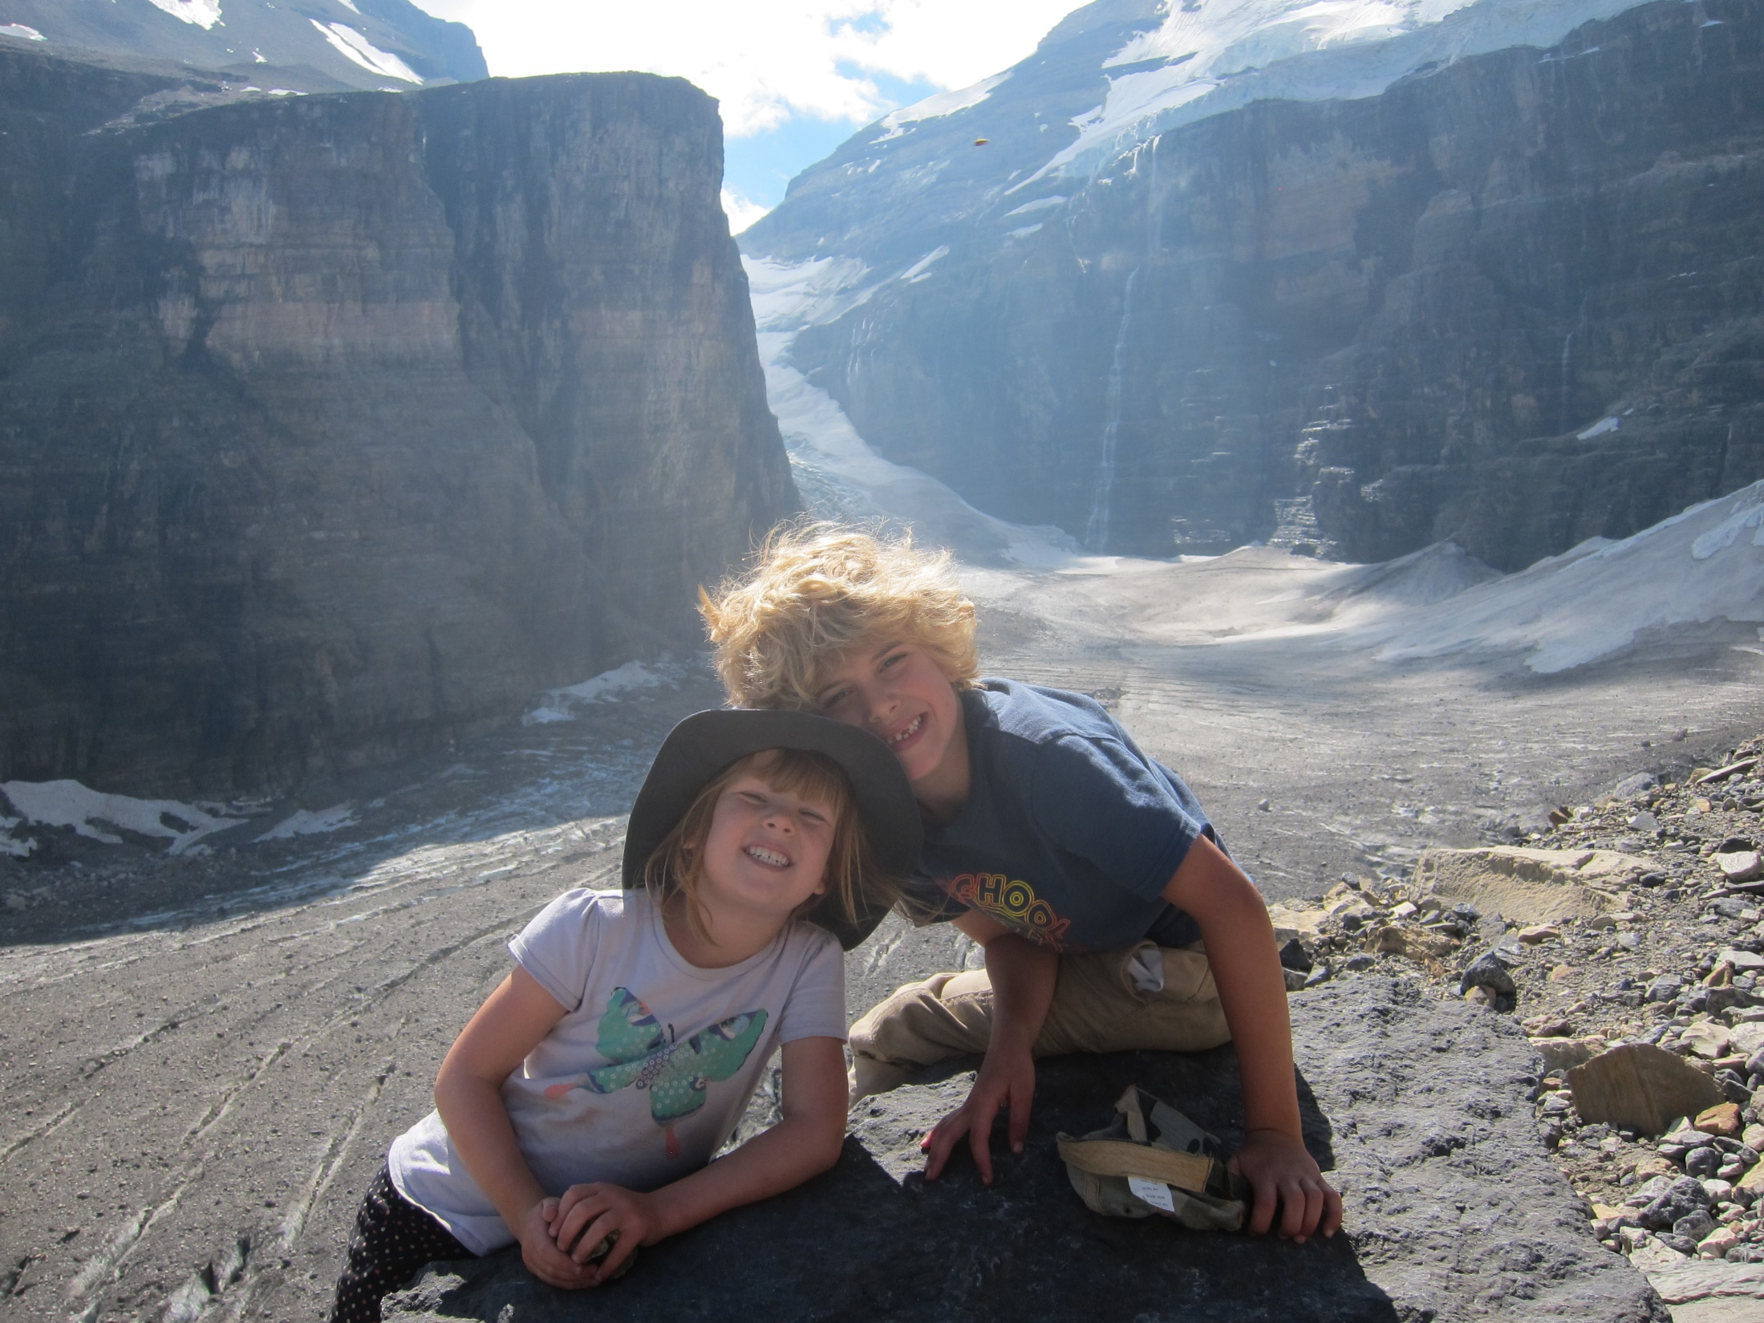

Slide 6
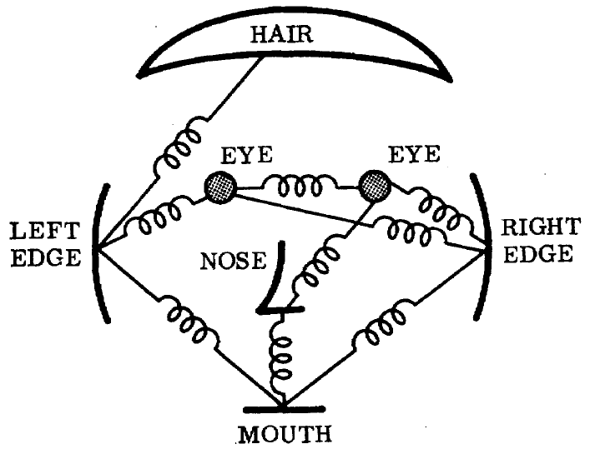
1973
a.k.a. constellation model
The representation and matching of pictorial structures, Fischler and Elschlager, 1973

Slide 7
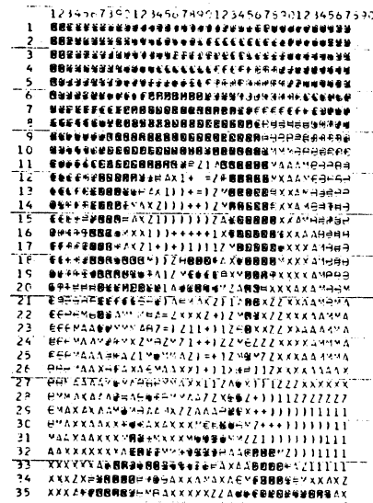
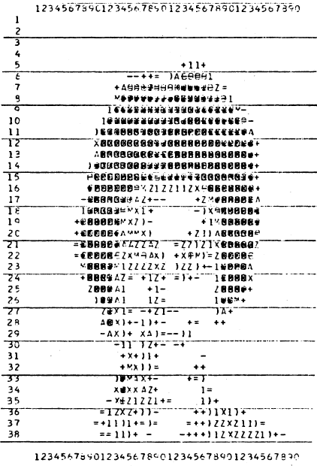
1973

Slide 8
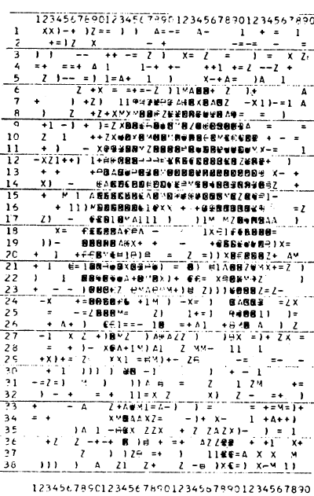
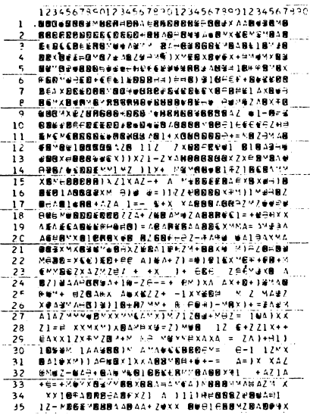
1973

Slide 9
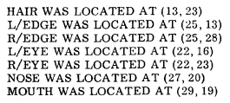
1973

Slide 10
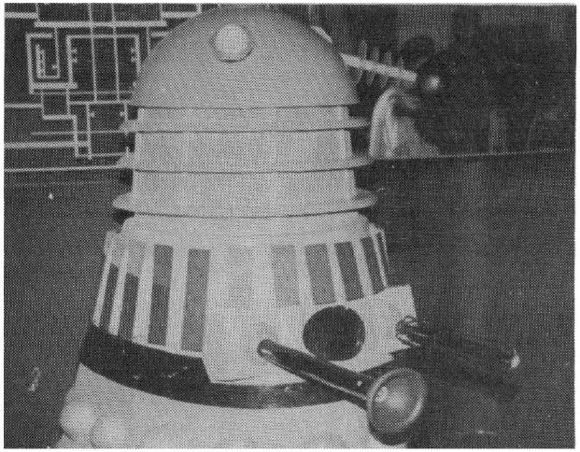
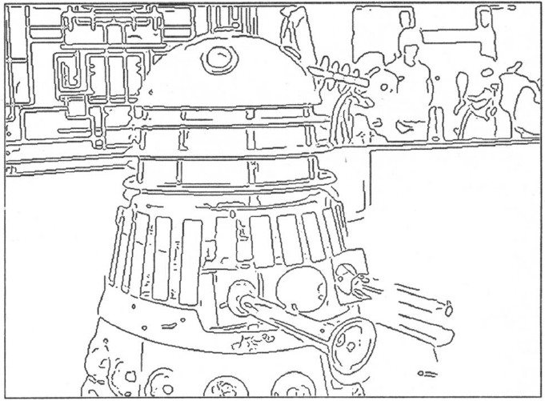
1980’s
AI winter…
…back to basics
A Computational Approach to Edge Detection, Canny 1986

Slide 11
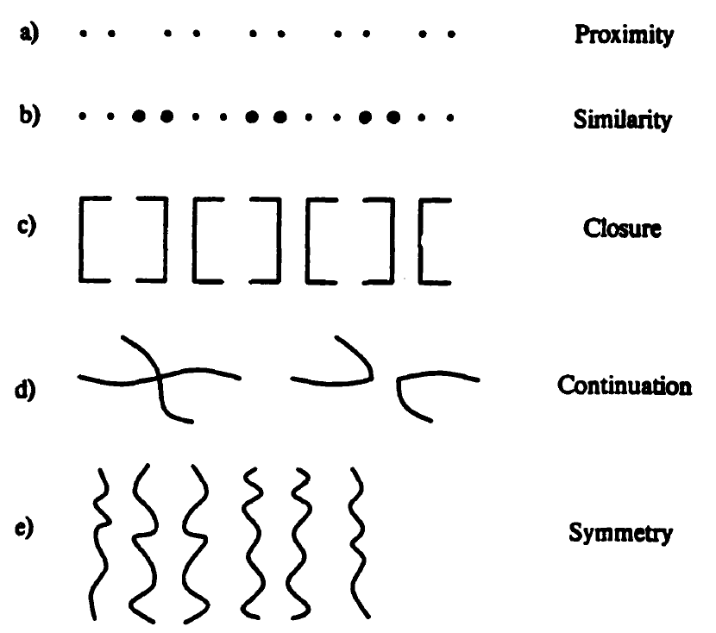
1984
Perceptual Organization and Visual Recognition, David Lowe, 1984

Slide 12
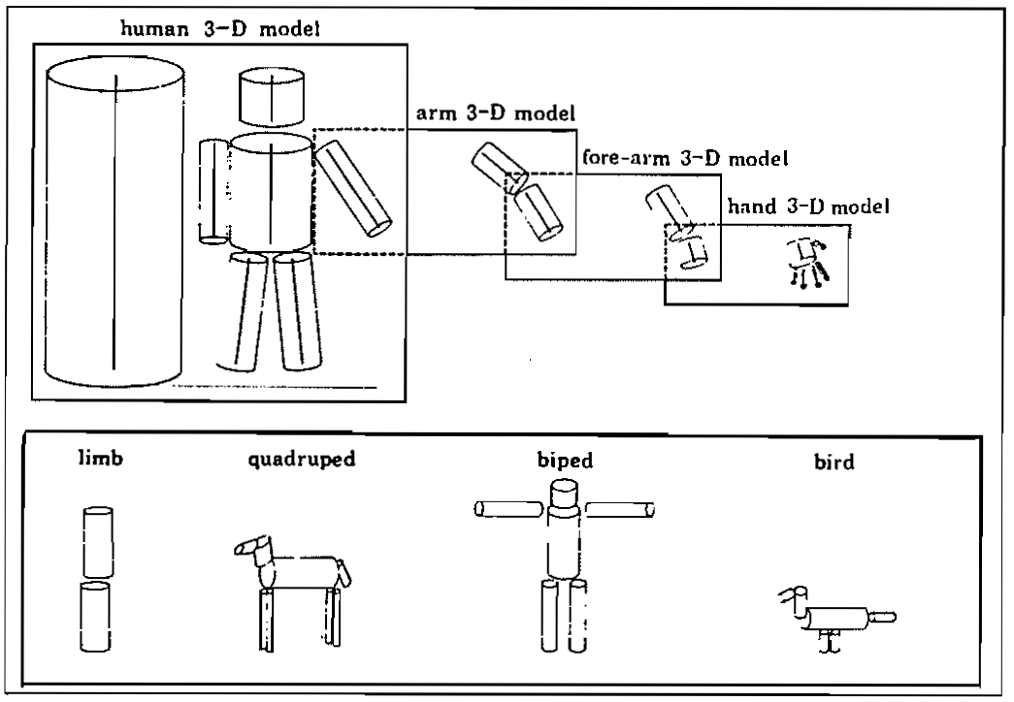
1986
Perceptual organization and the representation of natural form, Alex Pentland, 1986

Slide 13
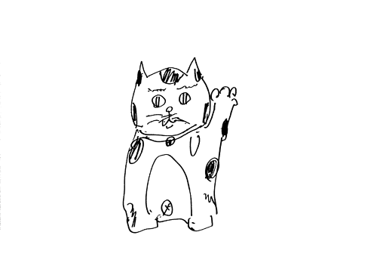
Goodbye
science

Slide 14
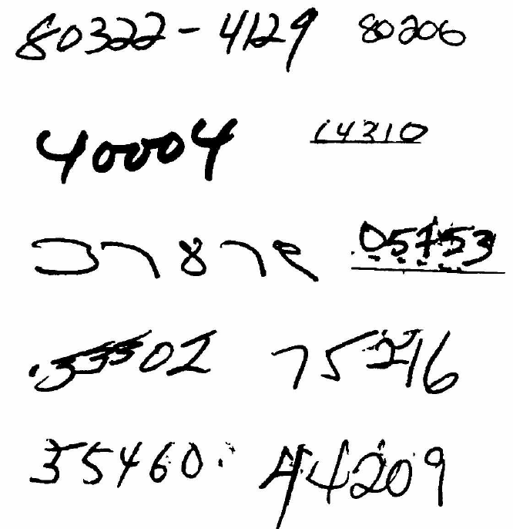
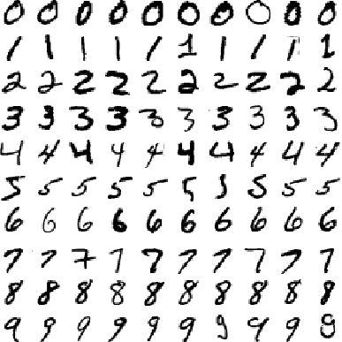
1989
MNIST
Zip codes
Backpropagation applied to handwritten zip code recognition, Lecun et al., 1989

Slide 15
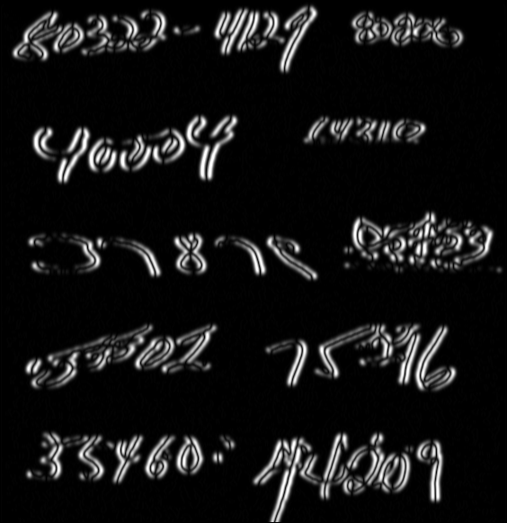
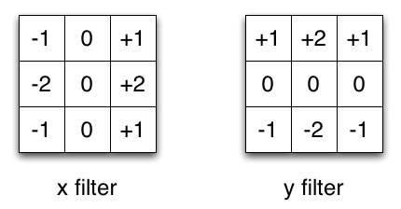

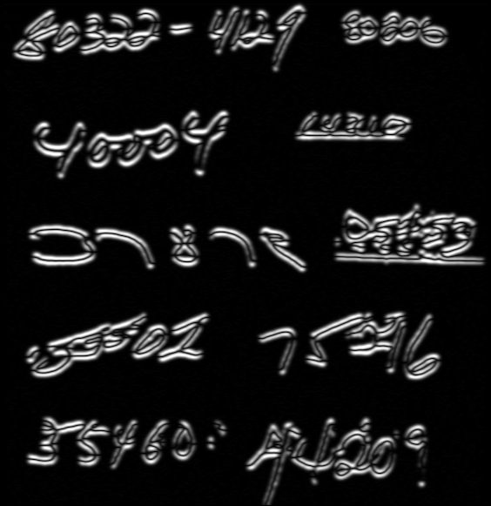
Filters
Input

Slide 16
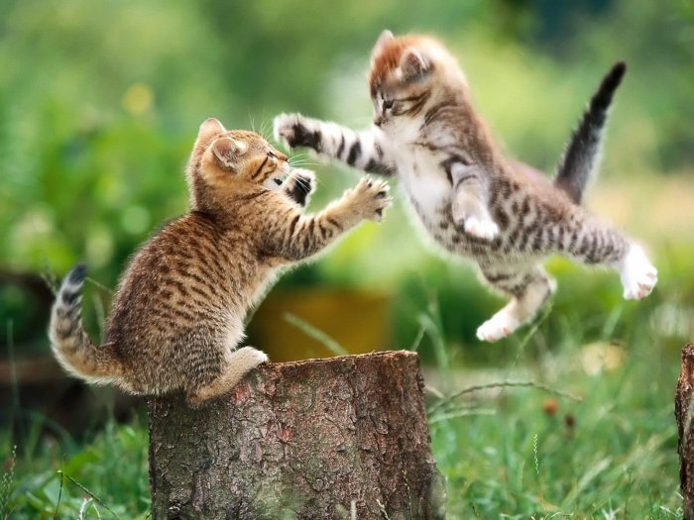
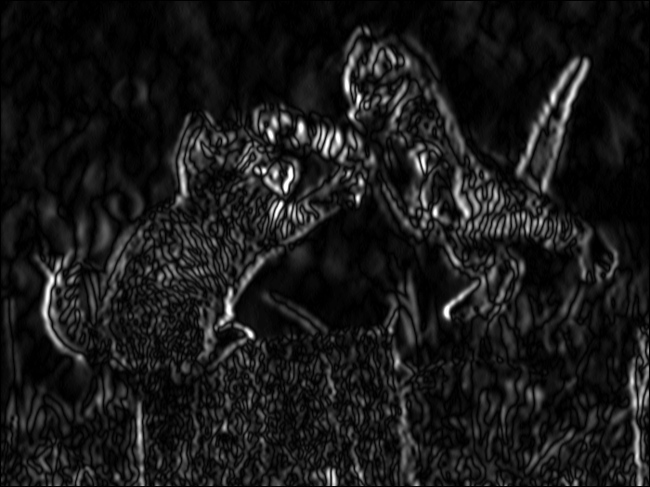
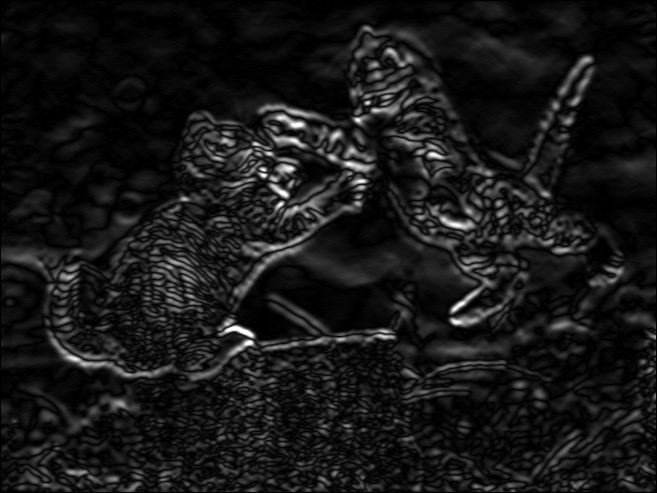

Slide 17
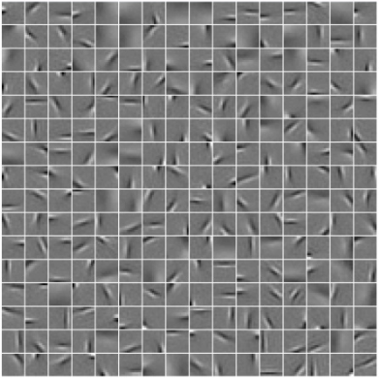
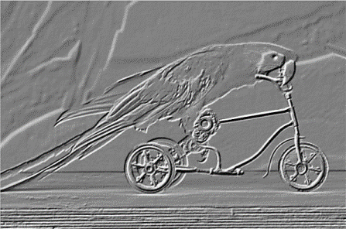
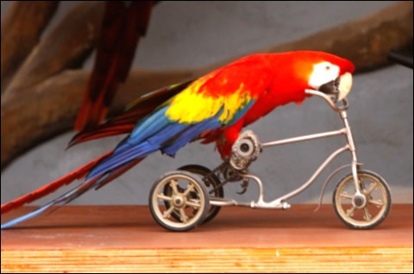
1989
Pooling
Convolution
Image

Slide 18
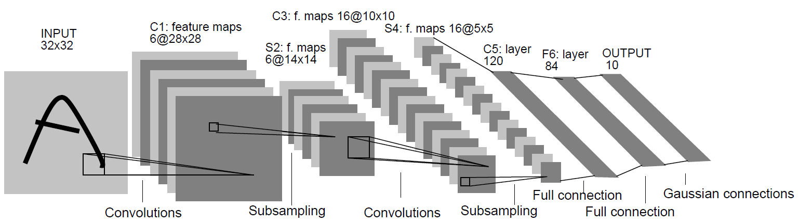
1989
Backpropagation applied to handwritten zip code recognition, Lecun et al., 1989

Slide 19
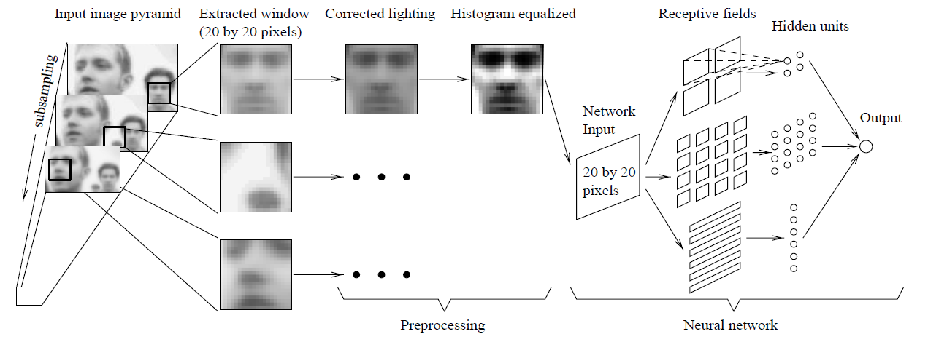
1998
Faces
Neural Network-Based Face Detection, Rowley at al., PAMI 1998

Slide 20
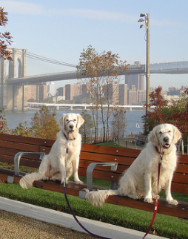
Classification
vs.
Detection
Dog
Dog
Dog

Slide 21
Limits
Numbers worked great, and so did faces…
Why did other categories fail?
2 main reasons… (2012)

Slide 22
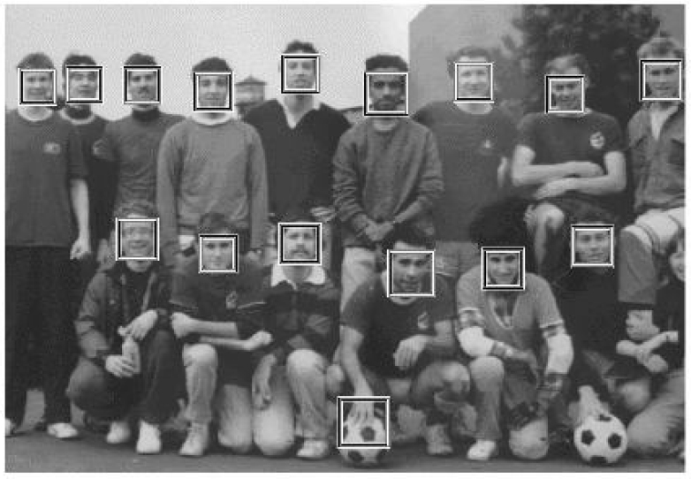
2001
Sliding window in real time!
Boosting + Cascade = Speed
Rapid Object Detection using a Boosted Cascade of Simple Features, Viola and Jones, CVPR 2001

Slide 24
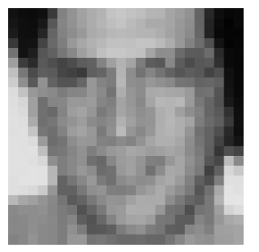
Why did it work?
Simple features (Haar wavelets)
-
= h
Integral images + Haar wavelets = fast

Slide 25
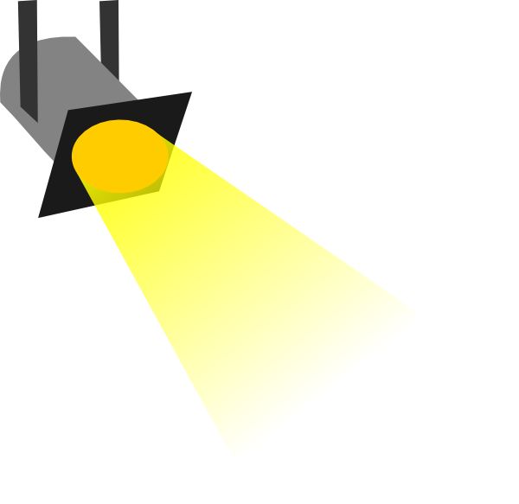



Slide 26
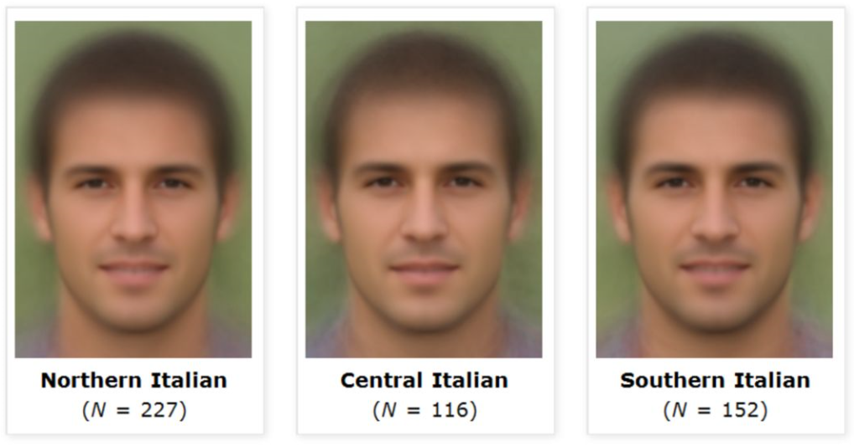

Slide 27
Why did it work?

Slide 28


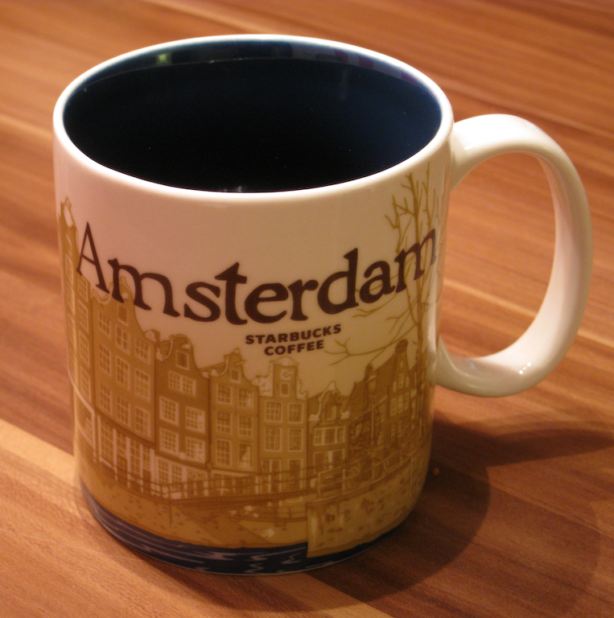

Why did it fail?

Slide 29
1999*
SIFT (Scale Invariant Feature Transform)
No more sliding windows (interest points)
Better features (use more computation)
Object Recognition from Local Scale-Invariant Features, Lowe, ICCV 1999.

Slide 30

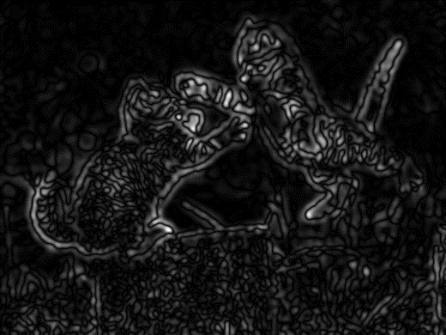

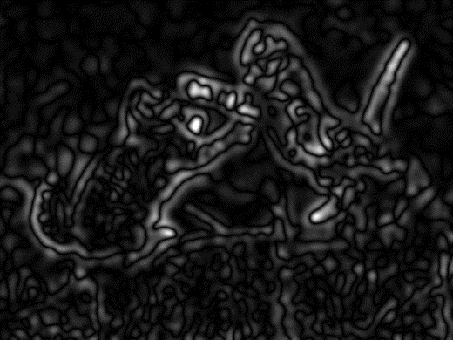

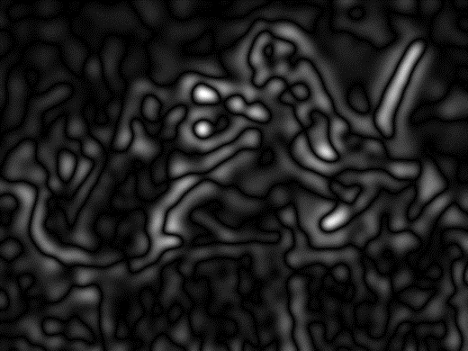

Less blur
Look for peaks!
More blur

Slide 31
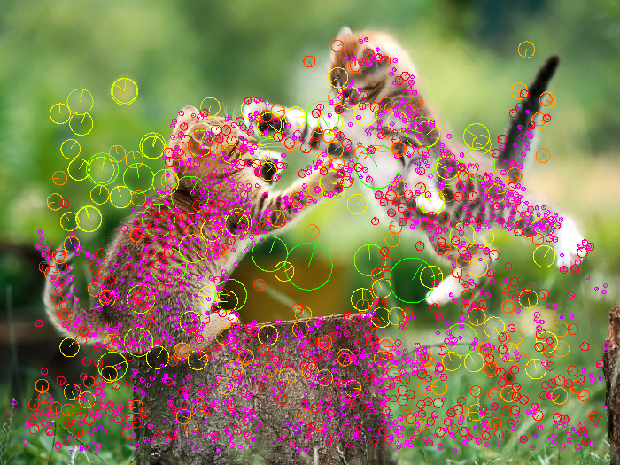

Slide 32
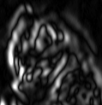
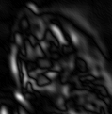
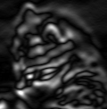
Better descriptor:
Distinctive image features from scale-invariant keypoints, Lowe, IJCV 2004

Slide 33
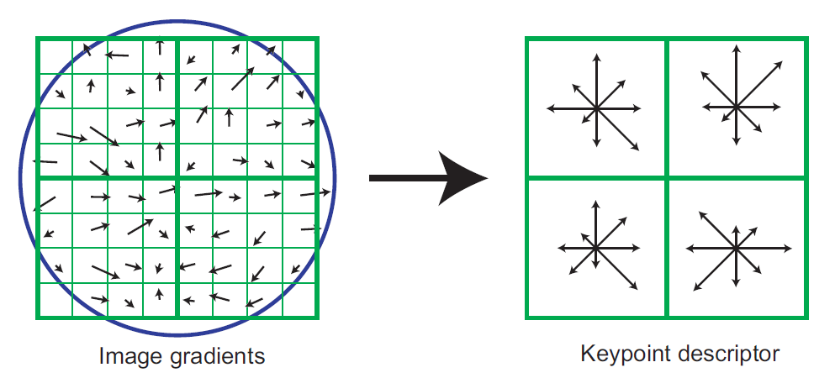
Better descriptor:
Distinctive image features from scale-invariant keypoints, Lowe, IJCV 2004

Slide 34
Truncated normalization
0.2
Histogram of pooled gradients
Distinctive image features from scale-invariant keypoints, Lowe, IJCV 2004

Slide 35
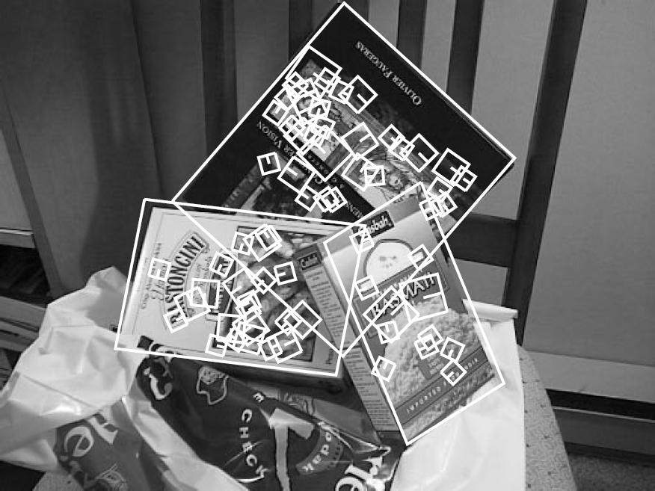
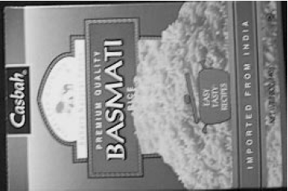
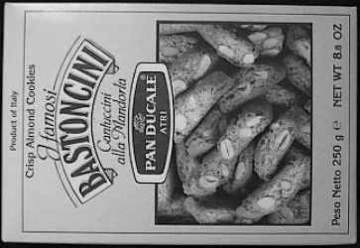
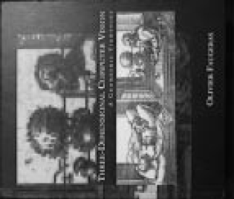
“Object instance” recognition (flat, textured objects)
What worked

Slide 36
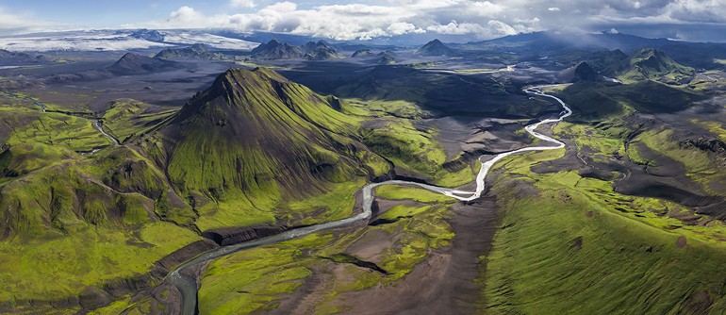
What worked
Panorama stitching
Recognizing panoramas, Brown and Lowe, ICCV 2003

Slide 37
What failed…

Slide 38
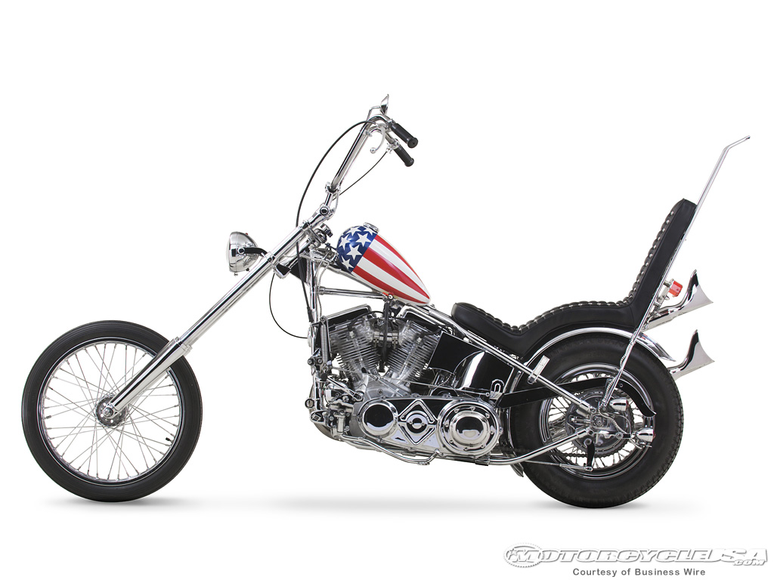

2003
Constellation model (redux)
Object Class Recognition by Unsupervised Scale-Invariant Learning, Fergus et al., CVPR 2003.

Slide 39


2003
Constellation model (redux)
The representation and matching of pictorial structures, Fischler and Elschlager, 1973
Joint Gaussian density

Slide 40

Interest points used to find parts:
Smaller number of candidate parts allows for more complex spatial models.

Slide 41
Why does it fail?

Slide 42

Why it fails
Interest points don’t work for category recognition

Slide 43
Too many springs…

Slide 44





Why it worked

Slide 45

2005 HOG (histograms of oriented gradients)
Histograms of oriented gradients for human detection, Dalal and Triggs, CVPR 2005.

Slide 46
Pedestrians
Defined by their contours
Cluttered backgrounds
Significant variance in texture
Interest points won’t work…
…back to sliding window.

Slide 47
2005 HOG (histograms of oriented gradients)

Slide 48
2005 HOG (histograms of oriented gradients)
SIFT

Slide 49
2005 HOG (histograms of oriented gradients)
Histograms of oriented gradients for human detection, Dalal and Triggs, CVPR 2005.

Slide 50
2005 HOG (histograms of oriented gradients)
Normalize locally not globally

Slide 51

2005 HOG (histograms of oriented gradients)
Presence > Magnitude

Slide 52
2005 HOG (histograms of oriented gradients)
For every candidate bounding box
Compute HOG features
Linear SVM
classifier
Non-maximal suppression
NMS

Slide 53
Why it worked
We can finally detect object boundaries in a reliable manner!
Hard negative mining
Computers are fast enough.

Slide 54





Why it failed

Slide 55


2006 Context
People don’t walk in the sky…
Putting Objects in Perspective, Hoiem, Efros, and Hebert, CVPR 2006.

Slide 56
Why it worked
Our world is not random
Some contextual cues may be reliably found

Slide 57
Why it failed
Many contextual cues are hard to detect
We need more data
Doesn’t help with false negatives

Slide 58














2004-2006 Caltech 101 and 256

Slide 59

2006
15-30 training images, up to ~70% accuracy.
Antonio Torralba

Slide 60


2007 PASCAL VOC
20 classes
The PASCAL Visual Object Classes (VOC) Challenge, Everingham, Van Gool, Williams, Winn and Zisserman, IJCV, 2010

Slide 61

2009 Caltech Pedestrian
1 class, lots of instances.
Pedestrian Detection: An Evaluation of the State of the Art, Dollár, Wojek, Schiele and Perona, PAMI, 2012

Slide 62


2009 ImageNet
22K categories, 14M images
Corgi
Orb weaving spider
ImageNet: A Large-Scale Hierarchical Image Database, Deng, Dong, Socher, Li, Li and Fei-Fei, CVPR, 2009

Slide 63

2010 SUN
908 scene categories
Beer garden
SUN Database: Large-scale Scene Recognition from Abbey to Zoo Xiao, Hays, Ehinger, Oliva, and Torralba, CVPR, 2010.

Slide 64


Slide 65
Why it failed

Slide 66

2008 DPM (Deformable parts model)
Object Detection with Discriminatively Trained Part Based Model, Felzenszwalb, Girshick, McAllester and Ramanan, PAMI, 2010

Slide 67

2008 DPM (Deformable parts model)
Object Detection with Discriminatively Trained Part Based Model, Felzenszwalb, Girshick, McAllester and Ramanan, PAMI, 2010

Slide 68
Star-structure
Computationally efficient (distance transform)
Distance transforms of sampled functions, Felzenszwalb and Huttenlocher, Cornell University CIS, Tech. Rep. 2004.

Slide 69

Multiple components

Slide 70
Why it worked
Multiple components
Deformable parts?
Hard negative mining
Good balance
"How important are 'Deformable Parts' in the Deformable Parts Model?“, Divvala, Efros, and Hebert, Parts and Attributes Workshop, ECCV, 2012

Slide 71
Why it failed…

Slide 72







Human debugging
Is it a head, torso, arm, leg, foot, hand, or nothing?
Head
Leg
Nothing
Low resolution 20x20 pixels
Feet
Head
?
Finding the Weakest Link in Person Detectors,
Parikh and Zitnick, CVPR 2011.

Slide 73


Part detections
Head
Torso
Arm
Hand
Leg
Foot
Person
Humans
Machine

Slide 74


Part detections
Arm
Head
Torso
Hand
Leg
Foot
Person
Machine
Humans

Slide 75


Part detections
Arm
Head
Torso
Hand
Leg
Foot
Person
Machine
Humans

Slide 76



AP results
Finding the Weakest Link in Person Detectors,
Parikh and Zitnick, CVPR 2011.

Slide 77



Slide 78

Do We Need More Training Data or Better Models for Object Detection? Zhu, Vondrick, Ramanan, Fowlkes, BMVC 2012.

Slide 79
DPM
Pooling
Limited capacity classifier
SVM
Something new?
HOG
Low-level features
Image

Slide 80
Images
2009
2012
30K
14M
ImageNet
Notes:
Caltech 256 : 30607 images (173)
ImageNet: 14,197,122 images (3741)

Slide 81
Categories
2009
2012
256
22K
ImageNet
Notes:
Caltech 256 : 256 categories (16)
ImageNet: 22000 categories (148)

Slide 82
Algorithms
2012
Dense
Dense
Dense
2009
Convolution
Convolution
Pooling
Convolution
SVM
Convolution
HOG
Convolution
Image
Image
Notes:
Caltech 256 : 256 categories (16)
ImageNet: 22000 categories (148)

Slide 83
Data
GPUs
Deep Learning
+
?

Slide 84
2012 ImageNet 1K (Fall 2012)

Slide 85
2012 ImageNet 1K (Fall 2012)

Slide 86

2012 DNNs (deep neural networks)
Image
Output
90% parameters
Imagenet Classification with Deep Convolutional Neural Networks, Krizhevsky, Sutskever, and Hinton, NIPS 2012

Slide 87
GPUs
+
Data*
Gradient-Based Learning Applied to Document Recognition, LeCun, Bottou, Bengio and Haffner, Proc. of the IEEE, 1998
Imagenet Classification with Deep Convolutional Neural Networks, Krizhevsky, Sutskever, and Hinton, NIPS 2012
* Rectified activations and dropout

Slide 88

2014 DNN vs. Detection

Slide 89
Aspect ratios?
DNNs are slow… (relatively)
224 x 224

Slide 90

Finding object candidates
Use low-level cues…
Segmentation As Selective Search for Object Recognition,
van de Sande, Uijlings, Gevers, Smeulders, ICCV 2011

Slide 91

Object detection
1. Input image
2. Extract region
proposals (~2k)
3. Compute CNN features
4. Classify regions
Rich Feature Hierarchies for Accurate Object Detection and Semantic Segmentation, Girshick, Donahue, Darrell, Malik, CVPR 2014.
Online classification demo:
http://decaf.berkeleyvision.org/

Slide 92


Slide 93


Slide 94


Slide 95


Slide 96


Slide 97


Slide 98


Slide 99


Slide 100


Slide 101


Slide 102


Slide 103


Slide 104


Slide 105

ImageNet (200 categories)

Slide 106

ImageNet (200 categories)

Slide 107


Slide 108
Why it fails…

Slide 109

PASCAL VOC

Slide 110


Slide 111


Antonio Torralba, MIT

Slide 112



Slide 113

Why it fails…
Learning and Transferring Mid-Level Image Representations using Convolutional Neural Networks, Oquab, Bottou, Laptev, Sivic, CVPR 2014

Slide 114

Why it fails…
Correctly classified
Incorrectly classified
Intriguing properties of neural networks,
Szegedy, Zaremba, Sutskever, Bruna, Erhan, Goodfellow, Fergus, ICLR 2014.

Slide 115


Why it fails…
PANDA: Pose Aligned Networks for Deep Attribute Modeling, Zhang, Paluri, Ranzato, Darrell, Bourdev, CVPR 2014.
DeepFace: closing the gap to human-Level performance in face verification, Taigman, Yang, Ranzato, Wolf, CVPR 2014.

Slide 116
Finding object candidates
Use low-level cues…
Interest points all over again?
Segmentation As Selective Search for Object Recognition,
van de Sande, Uijlings, Gevers, Smeulders, ICCV 2011

Slide 117

http://mscoco.org
Microsoft COCO: Common Objects in Context, Lin, Maire, Belongie, Hays, Perona, Ramanan, Dollár, Zitnick, ECCV 2014.

Slide 118

Why a new dataset?
Continue our field’s momentum:
Detecting difficult instances (context)
Segmentation
Enabling new research directions

Slide 119

Detection in Context
Instance segmentation
Non-iconic instances

Slide 120

Iconic object images

Slide 121
Iconic scene images

Slide 122
Non-iconic images

Slide 123

Notes:
Here we show the existing datasets that drive computer vision research in object classification and detection. We observed that the vision research is driven by the breadth of categories and the depth of number of instances for learning. COCO positions itself as a dataset that have breadth in the most common objects and with enough instances in depth for algorithms to learn and validate.

Slide 124

Notes:
Here is a figure to show how much contextual information in an image by looking at how many categories appear per image. Almost every image in SUN database has 2+ categories. COCO has 80% of images that have 2 or more categories in an image. And ImageNet and PASCAL have less than 50% of images have multiple categories.

Slide 125


Slide 126

MS COCO
Over 77,000 worker hours (8+ years)
70-100 object categories (things not stuff)
330,000 images (~150k first release)
2 million instances (400k people)
Every instance is segmented
7.7 instances per image (3.5 categories)
Key points
5 sentences per image
http://mscoco.org
Notes:
Mention 35,000 hours.

Slide 127
The end
Look for Ross’s StAR talk in November!

