Slide 1
Moving AI forward
Larry Zitnick
Microsoft Research

Slide 2
Why?

Slide 3
Data
GPUs
Deep Learning
+
?

Slide 4
2012 ImageNet
1,000 category classification

Slide 5
2012 ImageNet
1,000 category classification

Slide 6
2012 ImageNet
1,000 category classification

Slide 7
What?

Slide 8
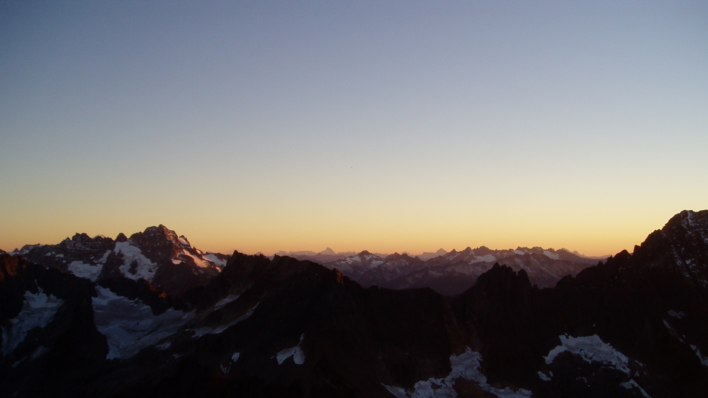
Case study:
Image captioning
“Long, blue, spiky-edged shadows crept out across the snow-fields, while a rosy glow, at first scarce discernible, gradually deepened and suffused every mountain-top, flushing the glaciers and the harsh crags above them.” John Muir

Slide 9
November 2014
Mind's Eye: A Recurrent Visual Representation for Image Caption Generation
Xinlei Chen, C. Lawrence Zitnick
(arXiv:1411.5654)
From Captions to Visual Concepts and Back
Hao Fang, Saurabh Gupta, Forrest Iandola, Rupesh Srivastava, Li Deng, Piotr Dollár, Jianfeng Gao, Xiaodong He, Margaret Mitchell, John C. Platt, C. Lawrence Zitnick, Geoffrey Zweig
(arXiv:1411.4952)
Long-term Recurrent Convolutional Networks for Visual Recognition and Description
Jeff Donahue, Lisa Anne Hendricks, Sergio Guadarrama, Marcus Rohrbach, Subhashini Venugopalan, Kate Saenko, Trevor Darrell (arXiv:1411.4389)
Explain Images with Multimodal Recurrent Neural Networks
Junhua Mao, Wei Xu, Yi Yang, Jiang Wang, Alan L. Yuille
(arXiv:1410.1090)
Show and Tell: A Neural Image Caption Generator
Oriol Vinyals, Alexander Toshev, Samy Bengio, Dumitru Erhan
(arXiv:1411.4555)
Deep Visual-Semantic Alignments for Generating Image Descriptions
Andrej Karpathy, Li Fei-Fei
(arXiv:1412.2306)
Unifying Visual-Semantic Embeddings with Multimodal Neural Language Models
Ryan Kiros, Ruslan Salakhutdinov, Richard S. Zemel
(arXiv:1411.2539)

Slide 10
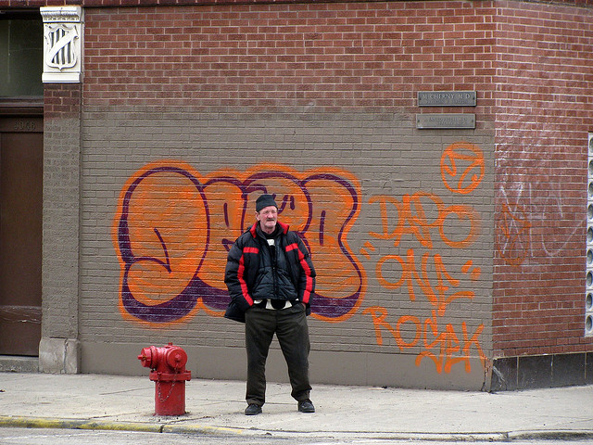
A man standing next to a fire hydrant in front of a brick building.
From Captions to Visual Concepts and Back, Fang et al., CVPR 2015

Slide 12
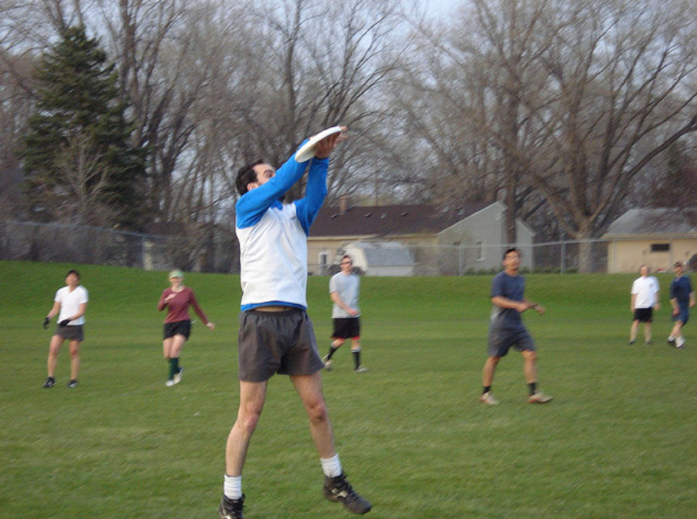
LSTM
A
group
of
young
people
…
CNN
LSTM
LSTM
LSTM
LSTM
LSTM
Show and Tell: A Neural Image Caption Generator, Vinyals et al., CVPR 2015

Slide 13
20%-30% of human subjects rate the automatically generated sentences equal to or better than human generated sentences.

Slide 14
35% - 85% of captions are identical to training captions.

Slide 15
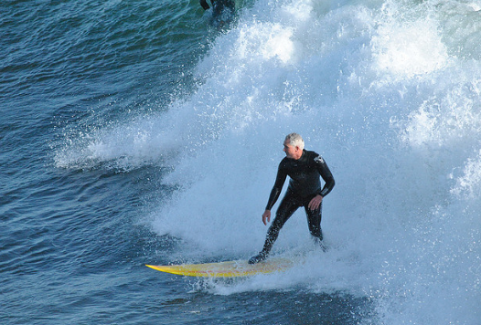
A man riding a wave on a surfboard in the water.

Slide 16
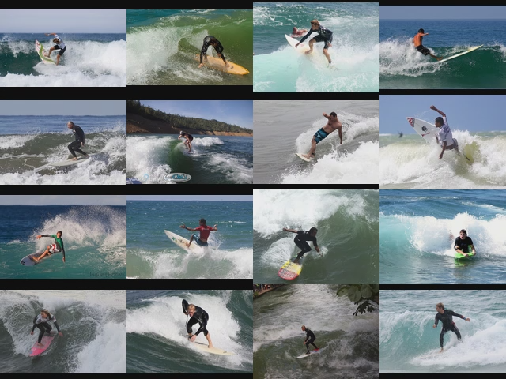

Slide 18
Evaluation
MS COCO Caption Challenge
CIDEr: Consensus-based Image Description Evaluation
Vedantam et al., CVPR, 2015.

Slide 19
Evaluation
MS COCO Caption Challenge

Slide 20
Evaluation
MS COCO Caption Challenge
Brno University

Slide 21
Evaluation
MS COCO Caption Challenge
Humans

Slide 22
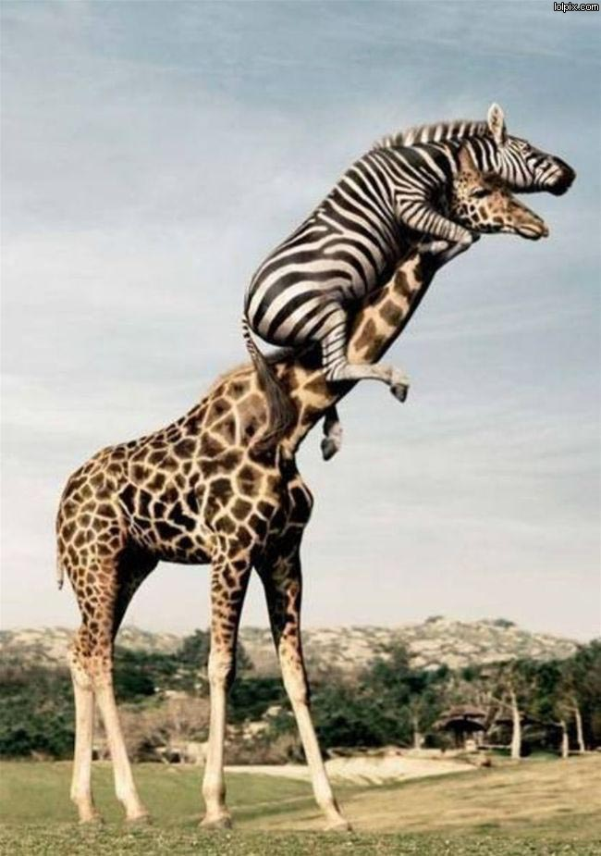
A crazy zebra climbing a giraffe to get a better view.
The limits of vision and language models…

Slide 23
80 object categories
160k images
2 million segmentations
5 sentences per image
http://mscoco.org
Notes:
Mention 35,000 hours.
Which we will have 330 images labeled and keypoints annotations.

Slide 24
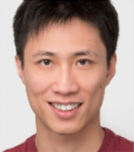
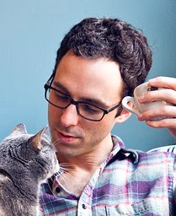
Tsung-Yi Lin
Genevieve Patterson
Serge Belongie
Pietro Perona
James Hays
Deva Ramanan
Michael Maire
Cornell Tech
Brown University
Cornell Tech
Caltech
Georgia Tech
CMU
TTI Chicago
Matteo Ronchi
Yin Cui
Lubomir Bourdev
Piotr Dollar
Ross Girshick
Larry Zitnick
Caltech
Cornell
Berkeley
Facebook
Facebook
Microsoft Research
Notes:
It is the result of a large collaboration between academia and industry. We felt is was critical for the dataset to be created by the community for the community. The students put in countless hours to make this dataset a reality.

Slide 25
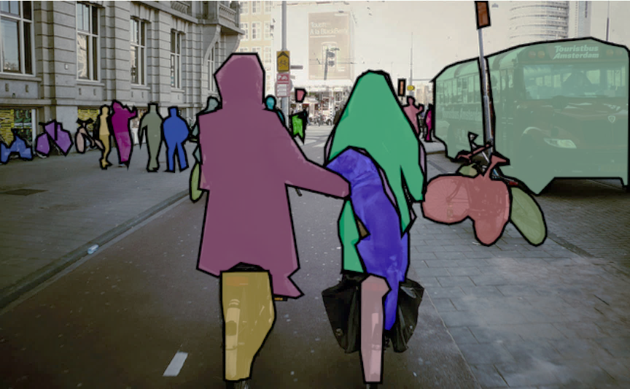

Slide 27
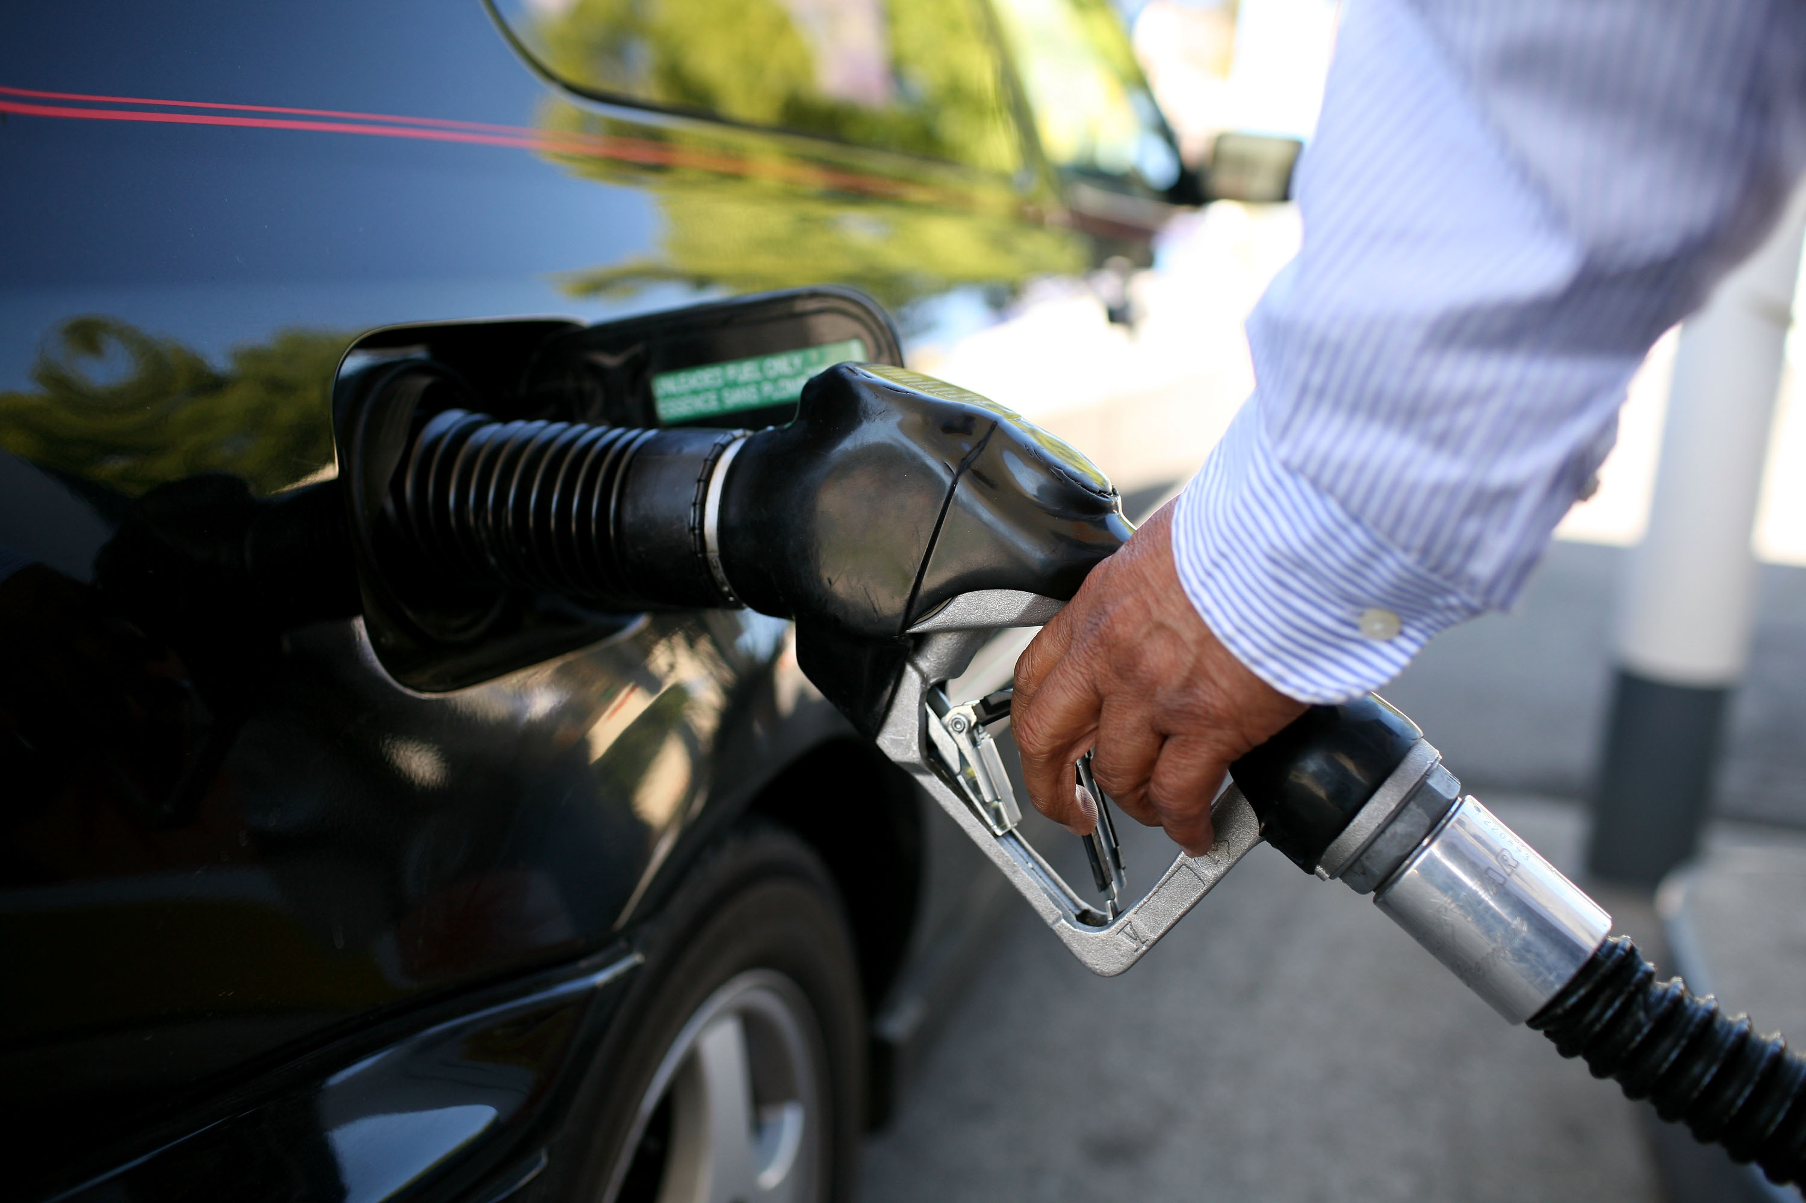

Slide 28
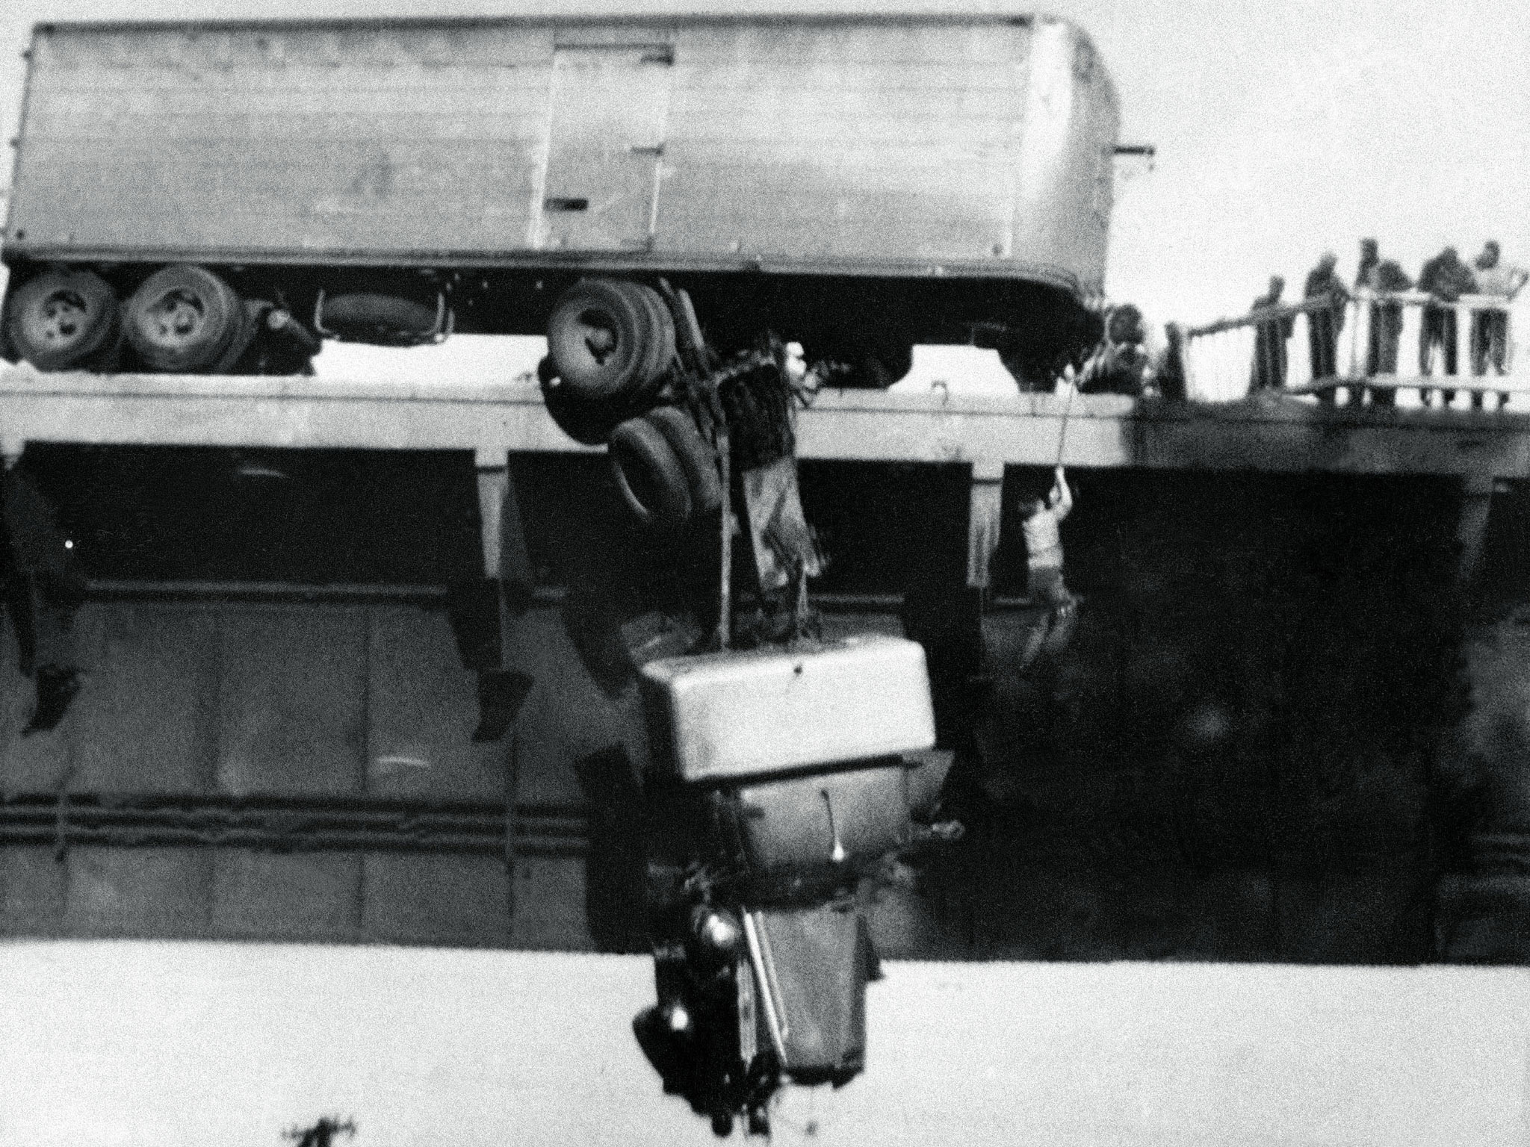
A man is rescued from his truck that is hanging dangerously from a bridge.
Virginia M. Schau
Notes:
Decisive moment

Slide 29
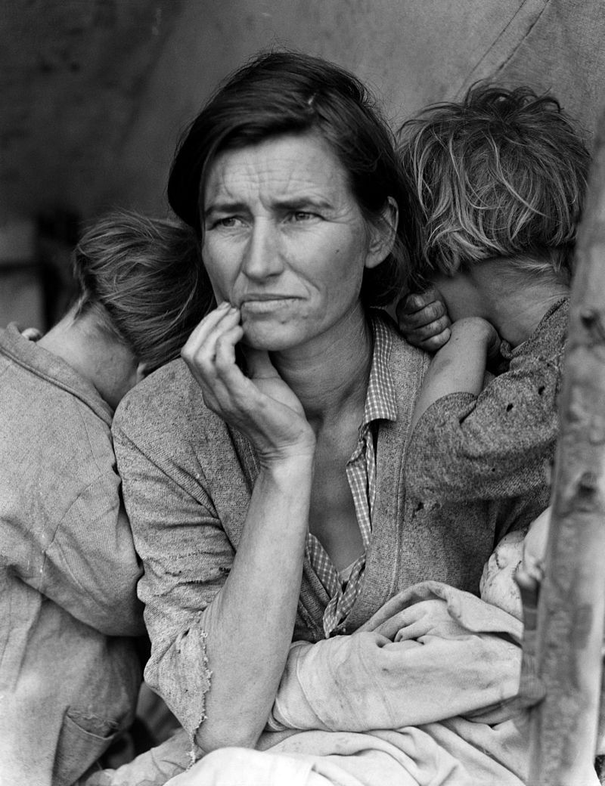
Migrant Mother, Dorothea Lange

Slide 30
Generalize
Reason
Knowledgeable

Slide 31
How?

Slide 32
Is photorealism necessary?

Slide 34
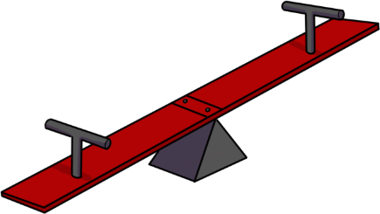
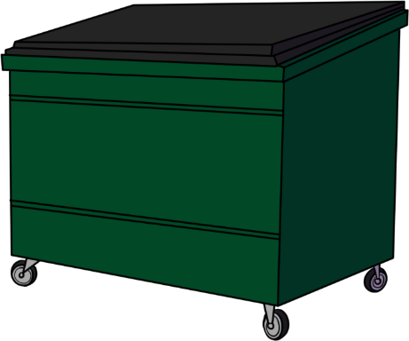

Slide 35
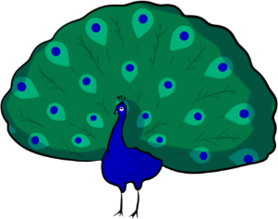

Slide 37
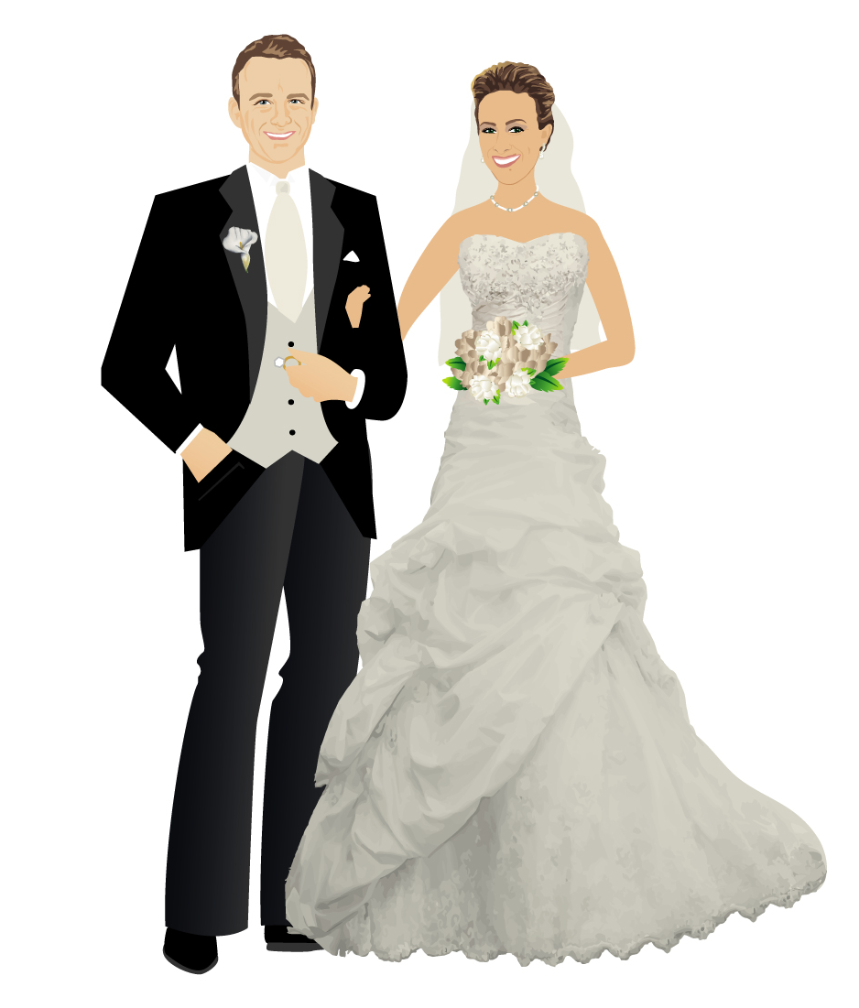
2005…
Algorithm
Dataset
How to write a paper:
1. Come up with algorithm.
2. Find/create dataset that works.

Slide 38
Datasets
Large = Expensive
Expensive = Scarce

Slide 39
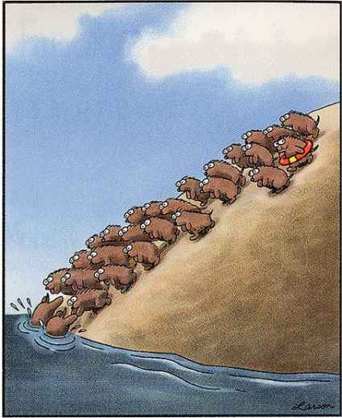
Scarce = Few

Slide 40
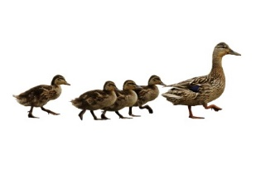
2015…
How to write a paper:
1. Pick a dataset.
2. Find an algorithm that works.
Dataset
Algorithms

Slide 41
How to create a dataset:
Pick problem (Generalize, Reason, Knowledgeable)
Find collaborators*
Gather lots of data
Create evaluation sever
Host challenges
*don’t skip this step, more = better

Slide 42
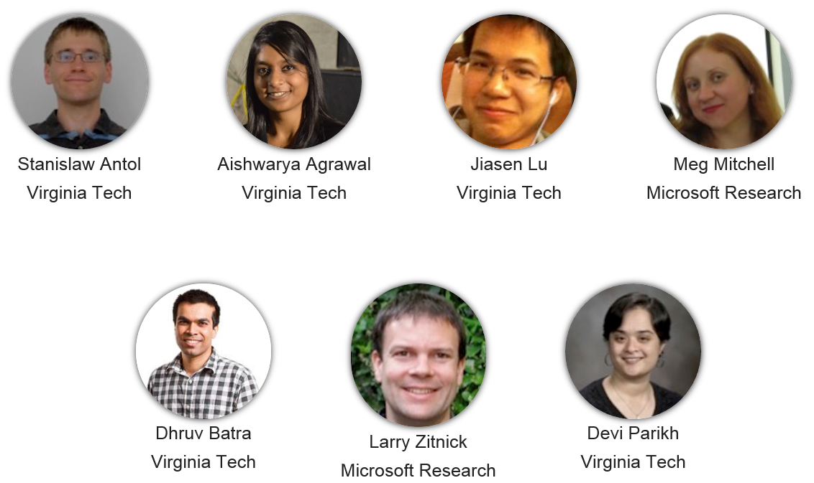
VQA: Visual Question Answering
VQA: Visual Question Answering
Antol et al., ICCV, 2015.
visualqa.org

Slide 43
VQA: Visual Question Answering
VQA: Visual Question Answering

Slide 44
VQA: Visual Question Answering
September 2015 (Full release)
204,721 MS COCO images (train, val, test)
50,000 abstract scenes
764,163 questions
9,934,119 answers
20+ person-job-years
visualqa.org

Slide 45
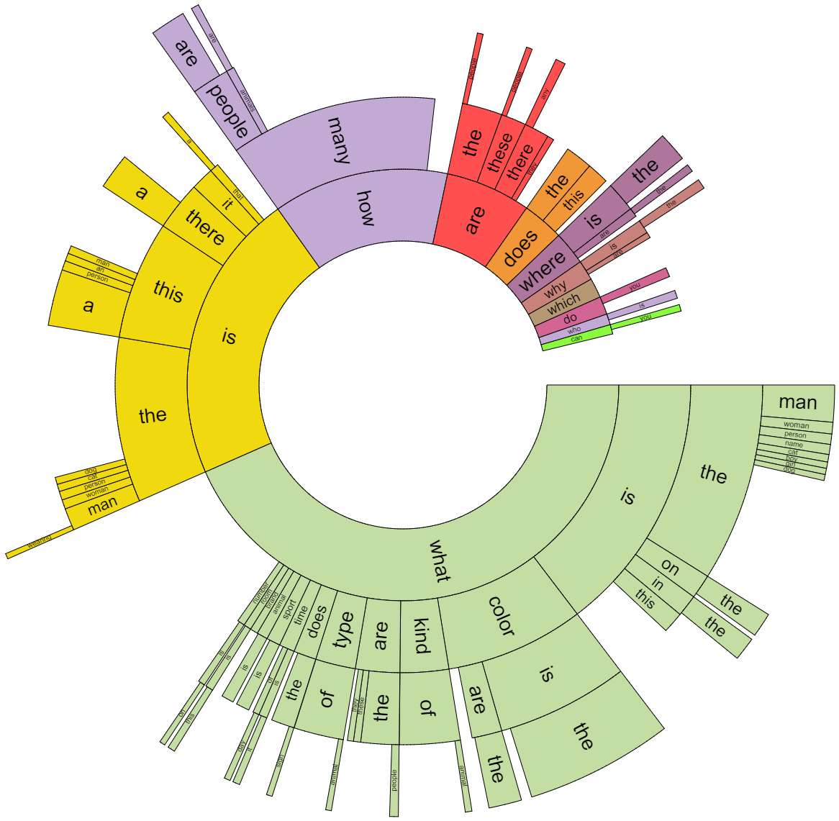

Slide 46
3-4 (15.3%) | 5-8 (39.7%) | 9-12 (28.4%) | 13-17 (11.2%) | 18+ (5.5%)
Is that a bird in the sky? | How many pizzas are shown? | Where was this picture taken? | Is he likely to get mugged if he walked down a dark alleyway like this? | What type of architecture is this?
What color is the shoe? | What are the sheep eating? | What ceremony does the cake commemorate? | Is this a vegetarian meal? | Is this a Flemish bricklaying pattern?
How many zebras are there? | What color is his hair? | Are these boats too tall to fit under the bridge? | What type of beverage is in the glass? | How many calories are in this pizza?
Is there food on the table? | What sport is being played? | What is the name of the white shape under the batter? | Can you name the performer in the purple costume? | What government document is needed to partake in this activity?
Is this man wearing shoes? | Name one ingredient in the skillet. | Is this at the stadium? | Besides these humans, what other animals eat here? | What is the make and model of this vehicle?

Slide 47
Conclusion
Language
Vision
Knowledge
Commonsense

